Slide 1
Finding and Reading Articles from the Harvard Business Review

Slide 2
HBR License (i.e. why we need this tutorial)
No direct links permitted through Sakai
“Top 500” articles can only be read online
No downloading
No printing

Slide 3
Sample article to find:
Edelman, D. C. (2010). Branding in The Digital Age. Harvard Business Review, 88(12), 62-69.
List of top 500 HBR articles from 2013: http://www.ala.org/rusa/sites/ala.org.rusa/files/content/sections/brass/Harvardbusinessreview/HBR_EBSCO_500_List_2013.pdf

Slide 4
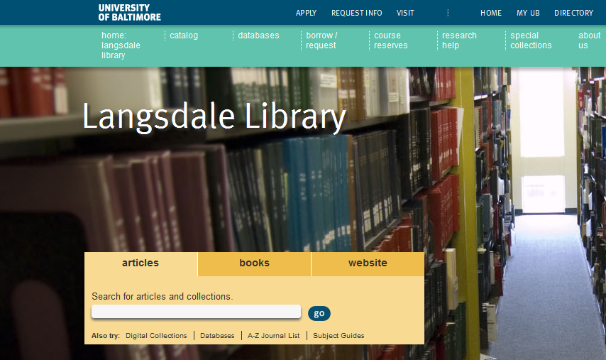
Click on A-Z Journal List

Slide 5
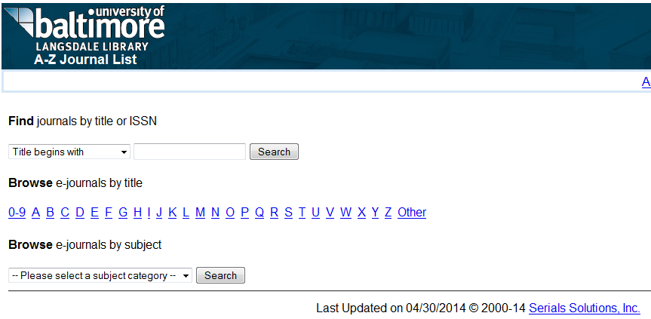
Search for “Title begins with”: Harvard Business Review
Harvard Business Review

Slide 6
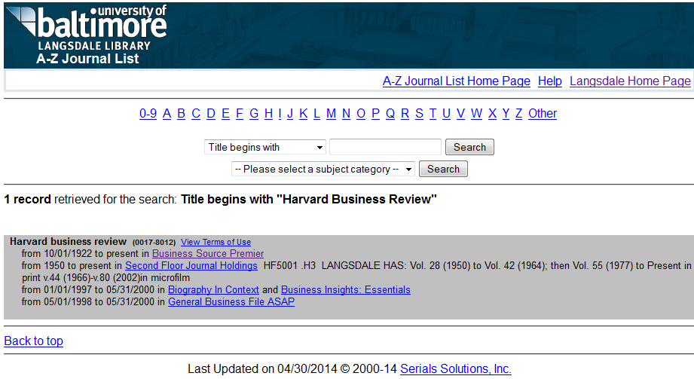
We have the HBR in Print. We also have it online through a database called Business Source Premier. Click on the link to Business Source Premier.

Slide 7
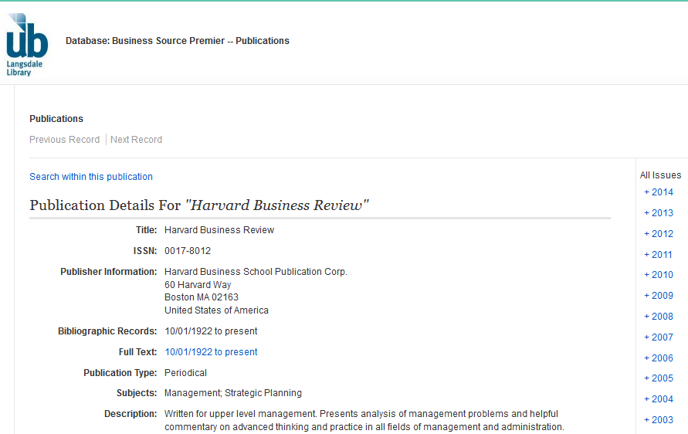
This is the page for the HBR in Business Source Premier. There are two ways to find articles from here.
1. Search for articles within this publication
2. Browse publication by date

Slide 8
Option 1: Click on “Search within this publication”

Slide 9
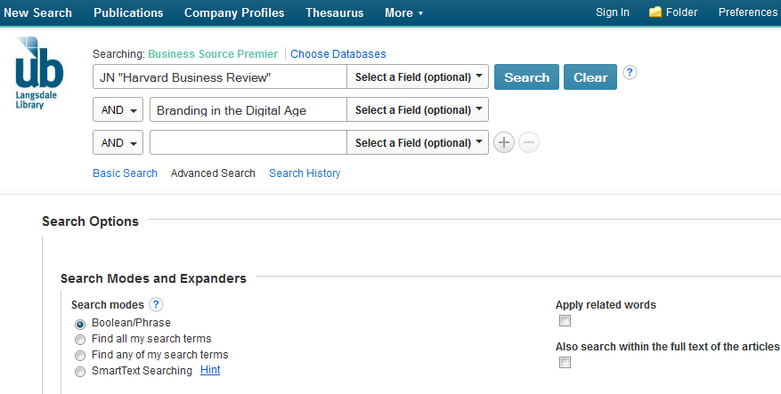
JN “Harvard Business Review” will be automatically put in the top search box, limiting your results to articles in the HBR. Enter the article title in the second search box. Optional: add the last name of the author to the third search box
1
2
3
1
2
3

Slide 10
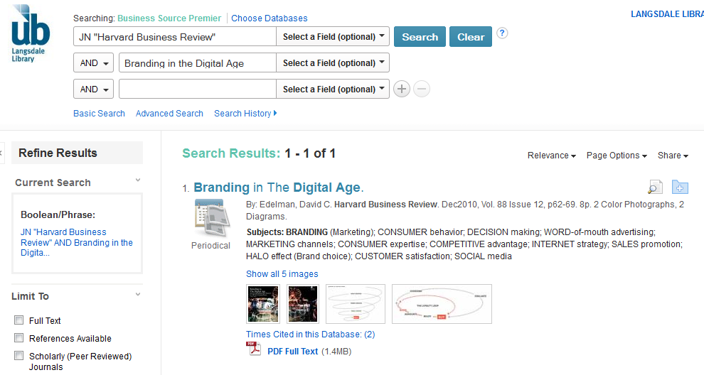
Click on the title of the article you want to read

Slide 11
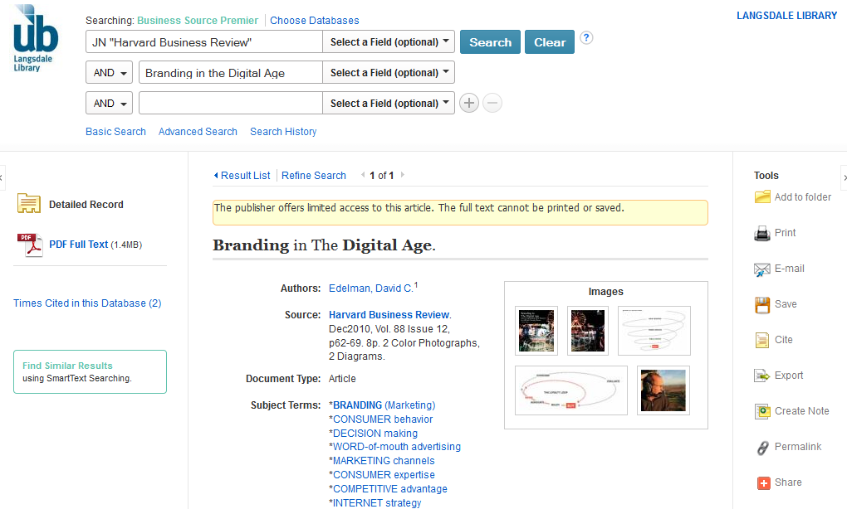
For articles on the Top 500 list, you will see a yellow box explaining the restrictions prohibiting printing or saving. If you don’t see the yellow box, you should be able to print or save the article. You can still read the article online by clicking on the “PDF Full Text Link”

Slide 12
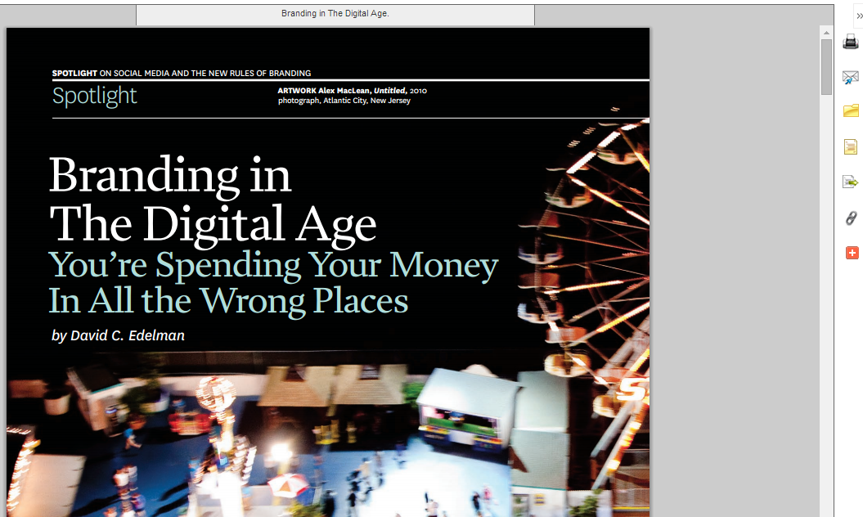
You can read this article in your browser, but the options for saving, printing and emailing will not work.

Slide 13
Option 2: Browse If you know the year and volume of publication, you can browse by year… Edelman, D. C. (2010). Branding in The Digital Age. Harvard Business Review, 88(12), 62-69

Slide 14
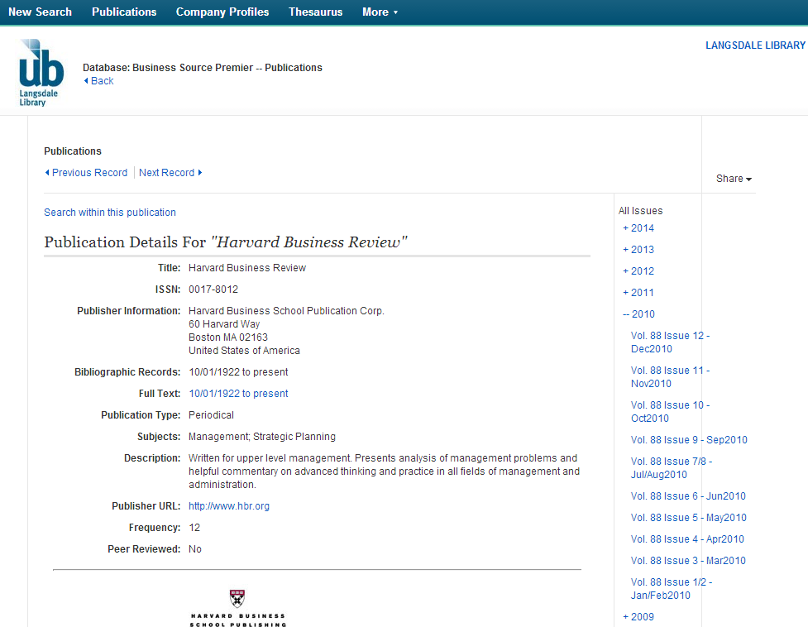
… issue number … Edelman, D. C. (2010). Branding in The Digital Age. Harvard Business Review, 88(12), 62-69

Slide 15
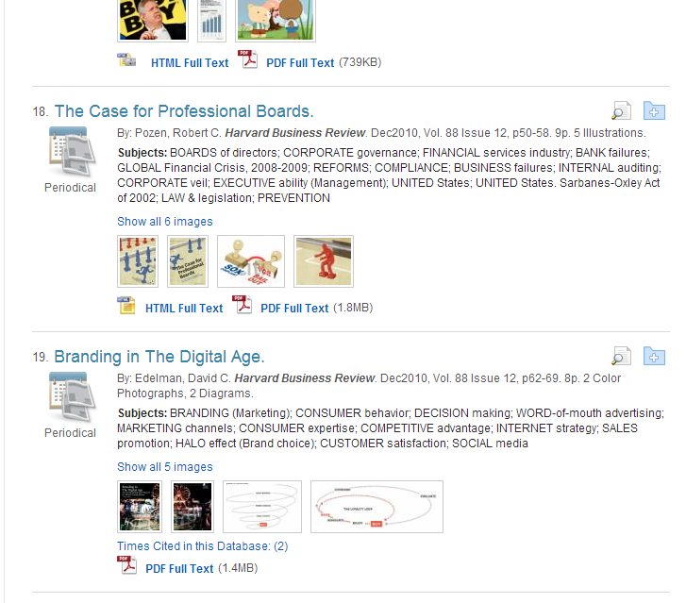
… and page number. Edelman, D. C. (2010). Branding in The Digital Age. Harvard Business Review, 88(12), 62-69

