Slide 1
Finding Population Data
Using American Factfinder
on the U.S. Census Bureau Website

Slide 2
Question
The US population included how many males aged 45-49 in 2010?
Tip: If you open a browser tab and go to http://www.census.gov
you can view this tutorial in one tab and follow along yourself in the other

Slide 3
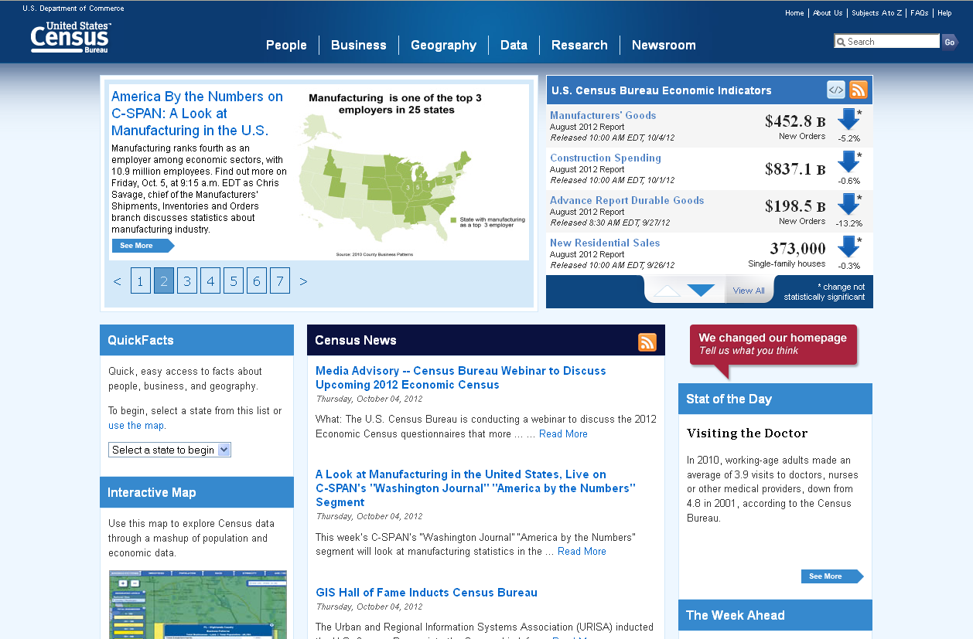
http://www.census.gov

Slide 4
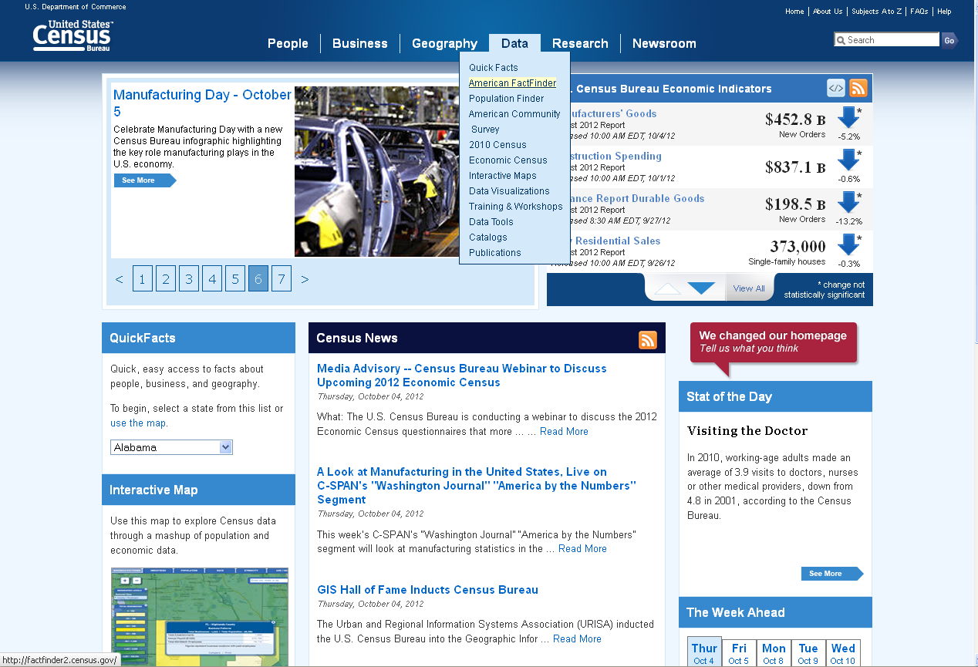
Click on Data → American Factfinder

Slide 5
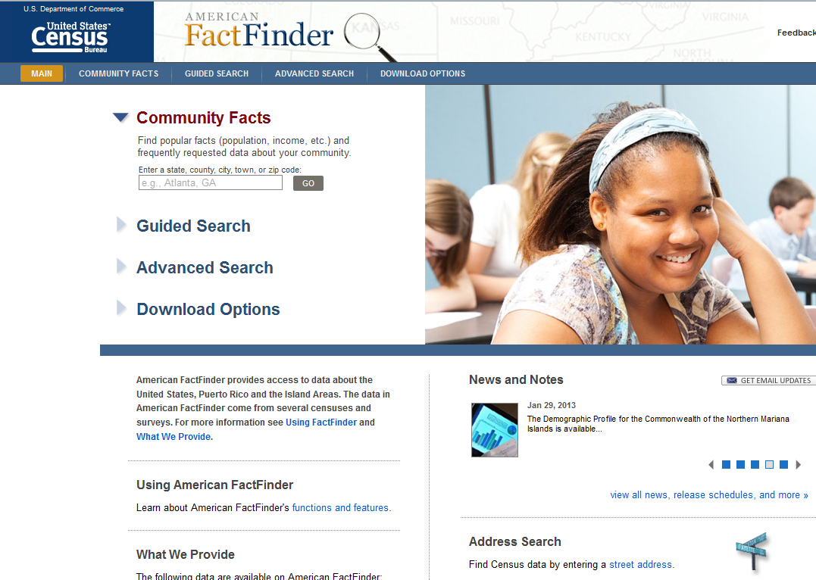
Click on Advanced Search

Slide 6
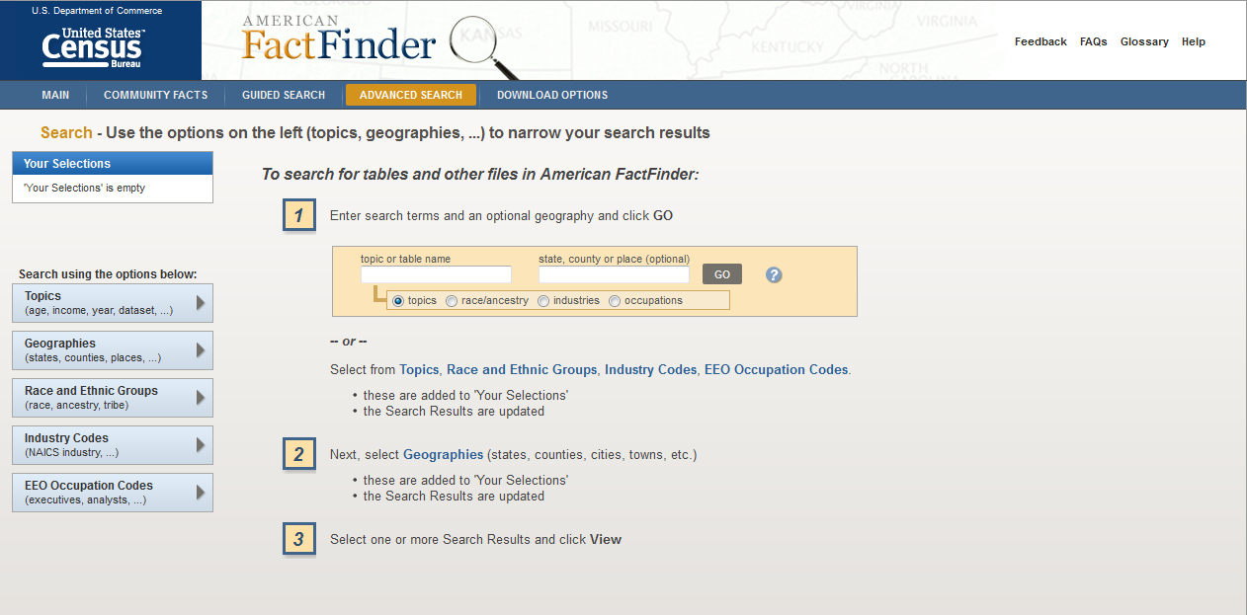
Click on Topics

Slide 7
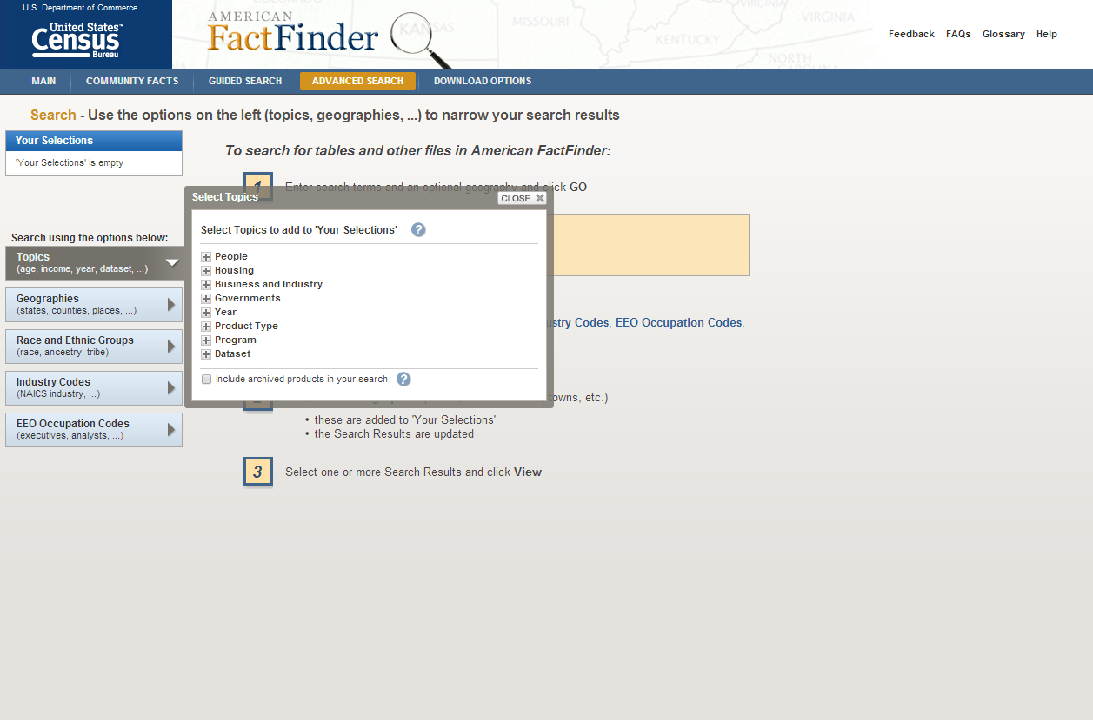
Expand “people”

Slide 8
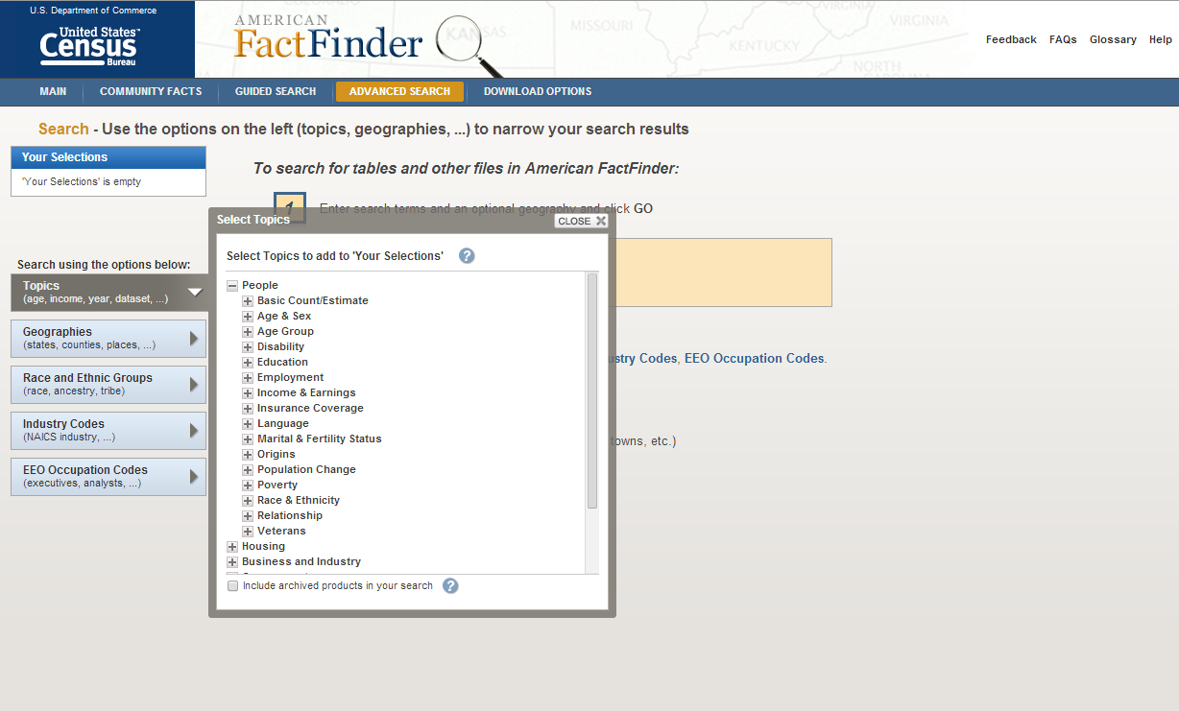
Expand “Age & Sex”

Slide 9
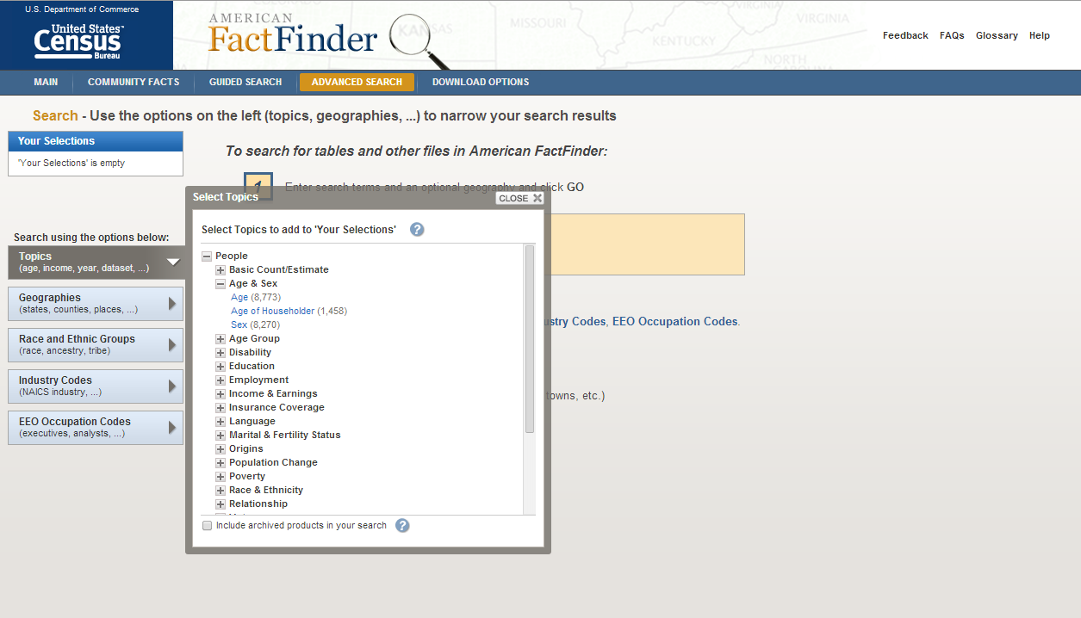
Select “Age”

Slide 10
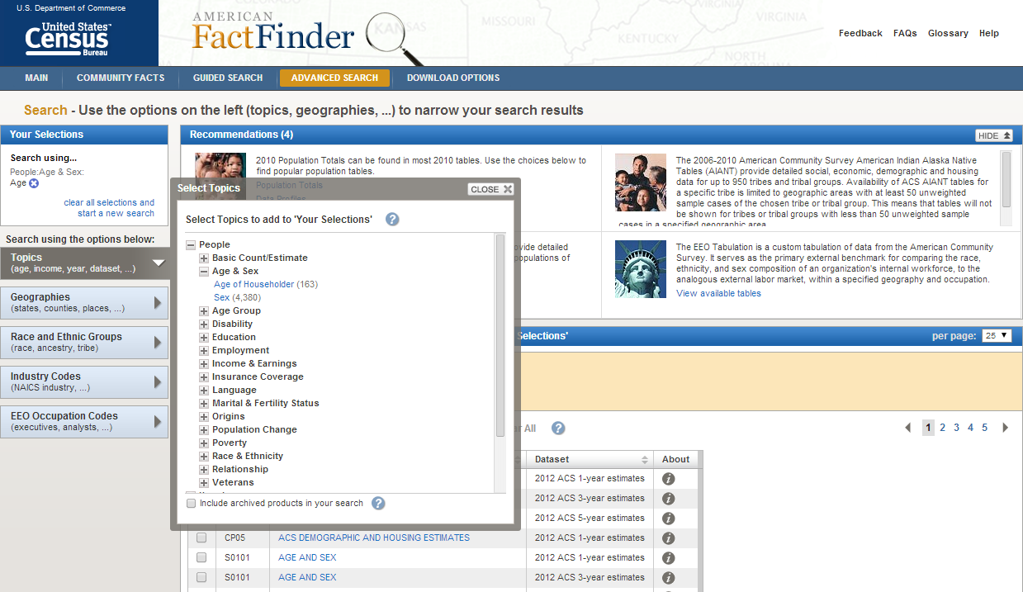
Age goes to the left to show
current selections.

Slide 11
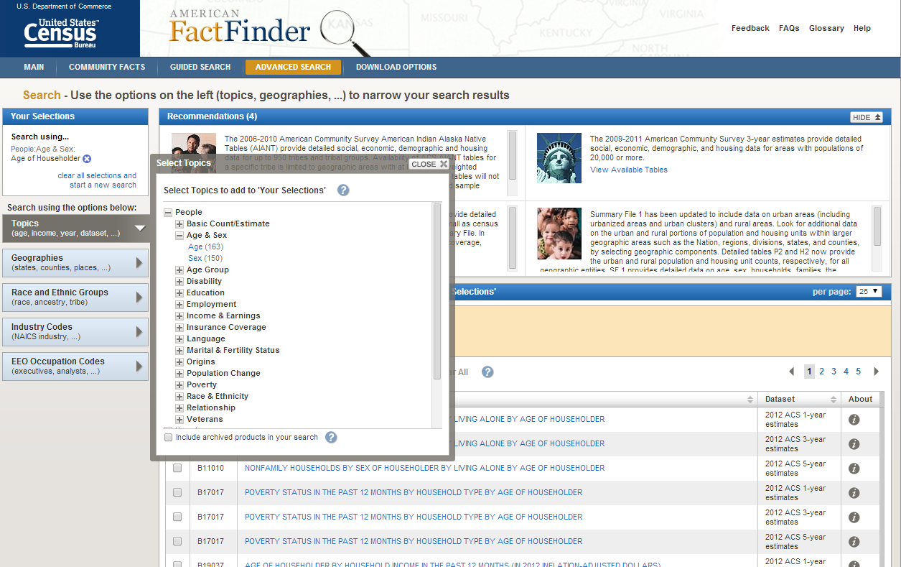
Tip: If you hit the wrong category (or want to search for different data) the Census website will remember you previous selections, even if you try to start over. You need to click on the “x” next to a category to remove it.

Slide 12
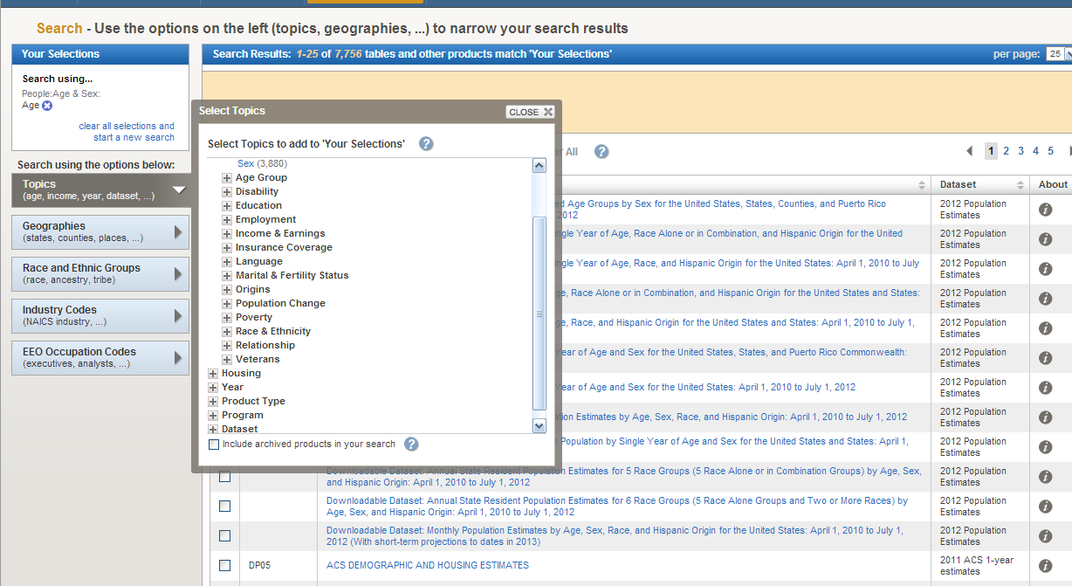
Once you have “Age” selected on the left, to find official 2010 Census figures, you need to set the year to 2010 (you may have to scroll down in the “Select Topics” window)
Expand Year

Slide 13
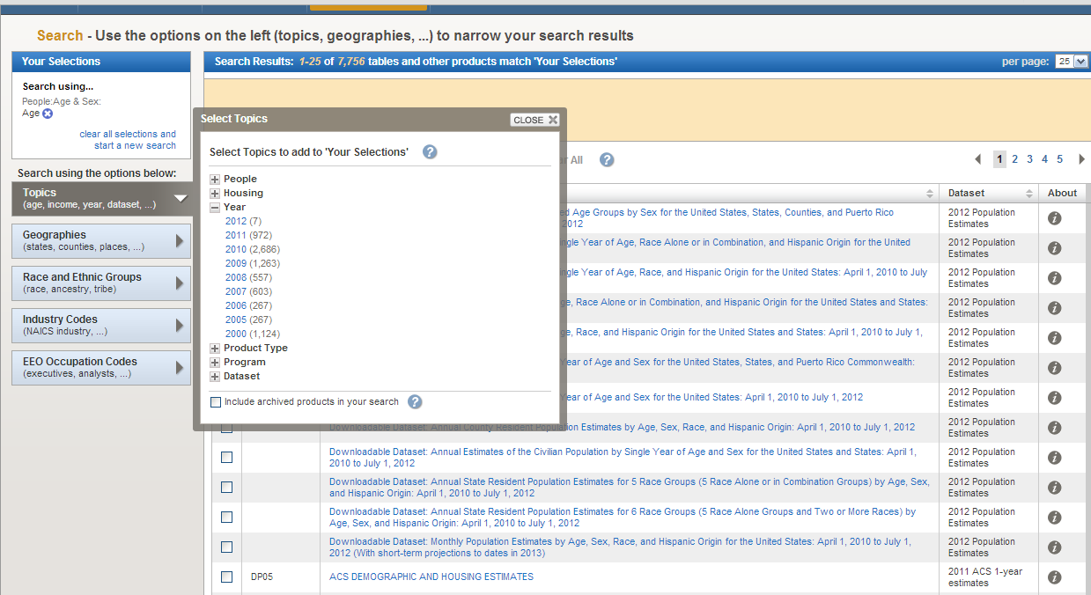
Select 2010

Slide 14
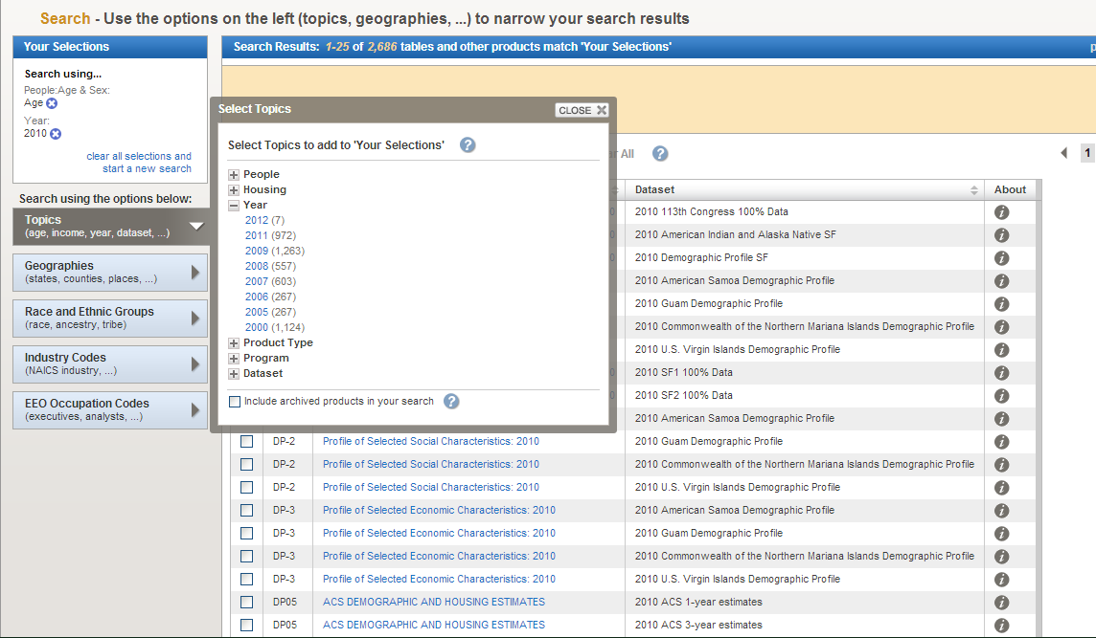
Age and Year are on the left to show current selections.
Close the “topics” box

Slide 15
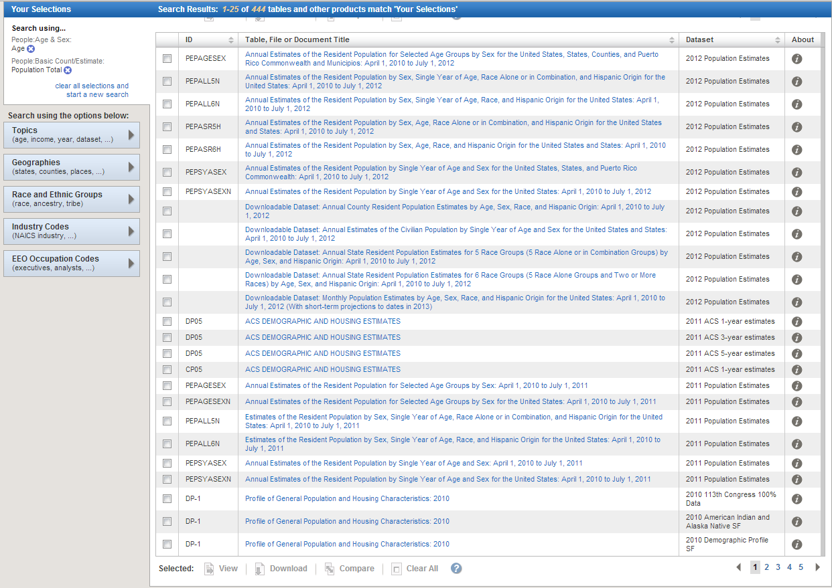
Which table has the data you need?
You may have to click on the “i” icon for more information on each table. One tip is that summary data from the official census should be in a table labeled SF-1.
Go to the next page of results to see more options.

Slide 16
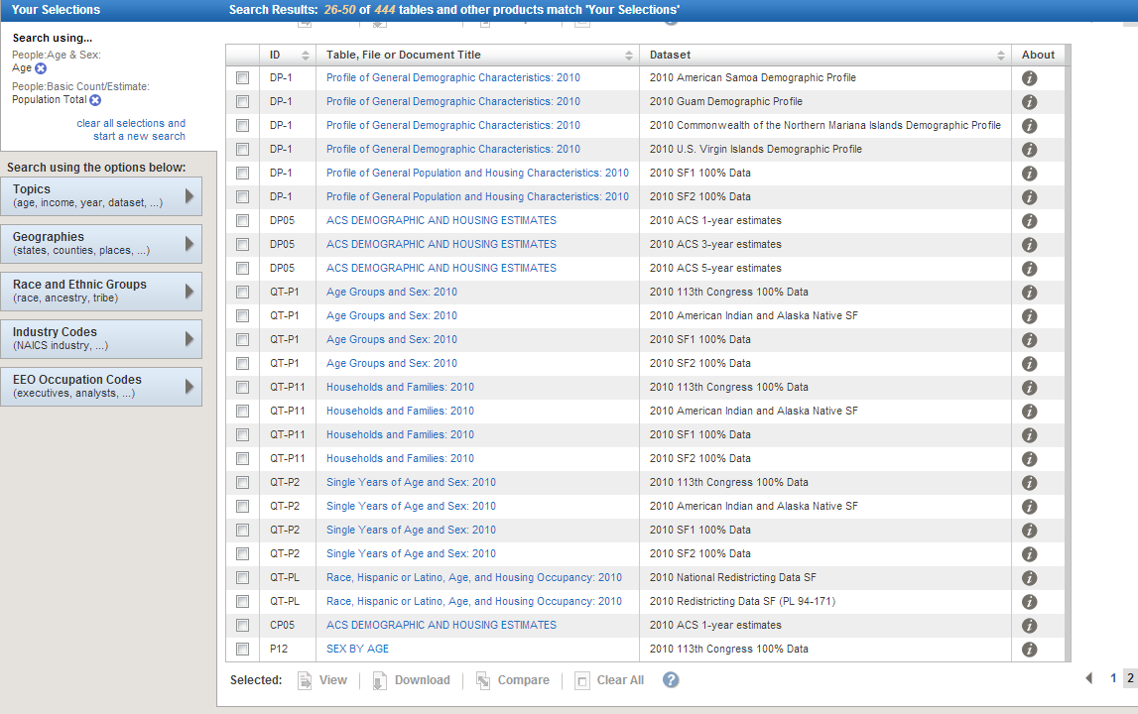
Sometimes you have to try a few different tables to find the data you want.
In this case, QT-P1 Age Group and Sex from the 2010 SF-1 100% Data happens to have what we need. (Note: the result order can vary over time, so this table may not be in this exact location on the page)

Slide 17
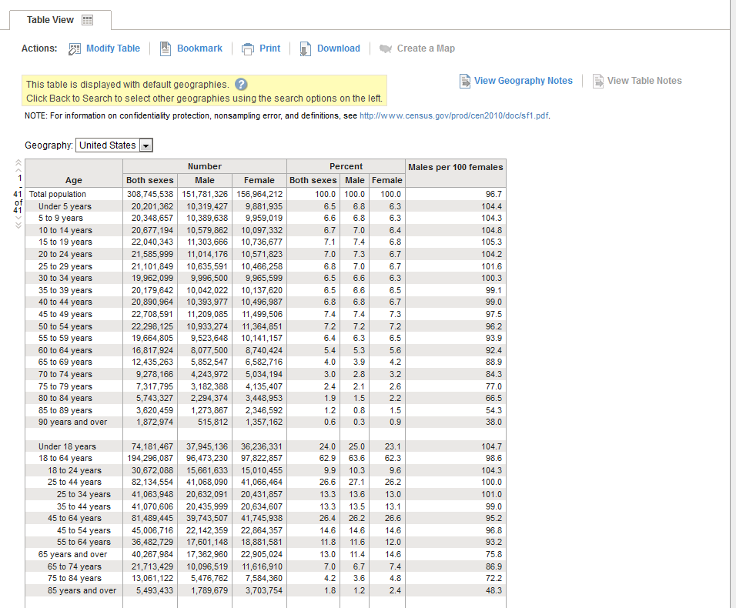
Q: The US population included how many males aged 45-49 in 2010?
Find the Intersection of “Males” and “45-49”
A: 11.2 million

Slide 18
Finding Population Projections
Using the US Census Bureau website

Slide 19
http://www.census.gov

Slide 20
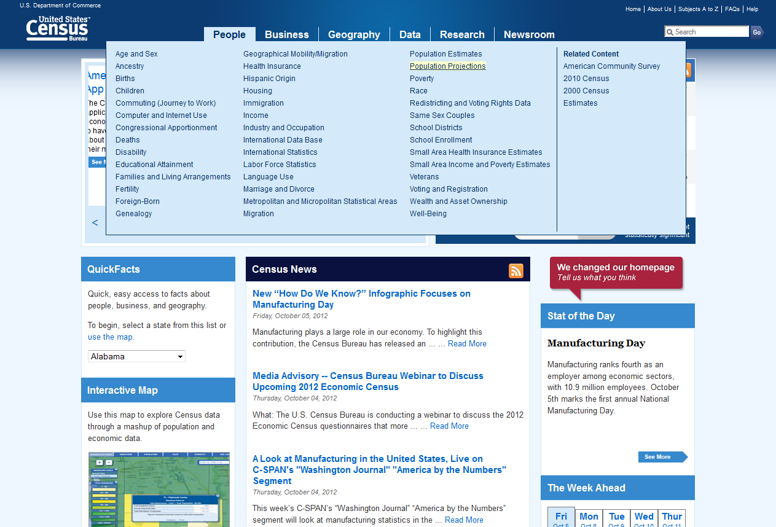
Click on People → Population projections

Slide 21
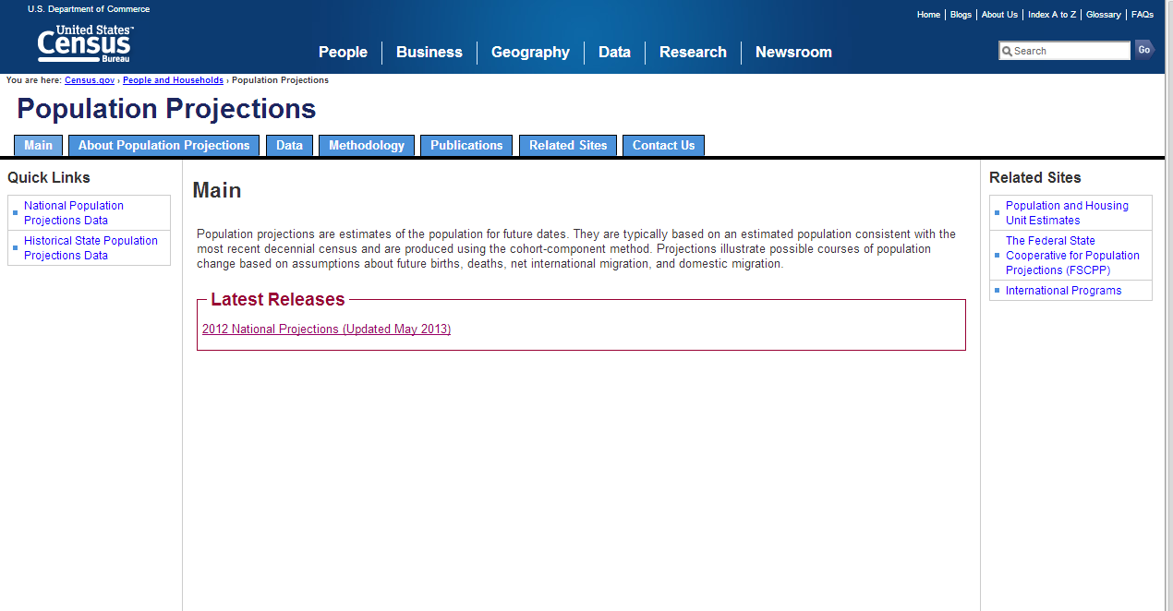
Click on 2012 National Projections

Slide 22
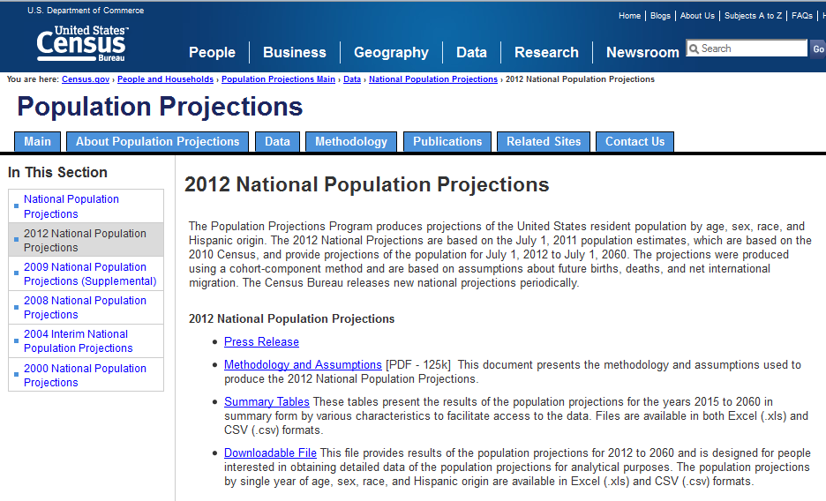
Click on “Summary Tables”

Slide 23
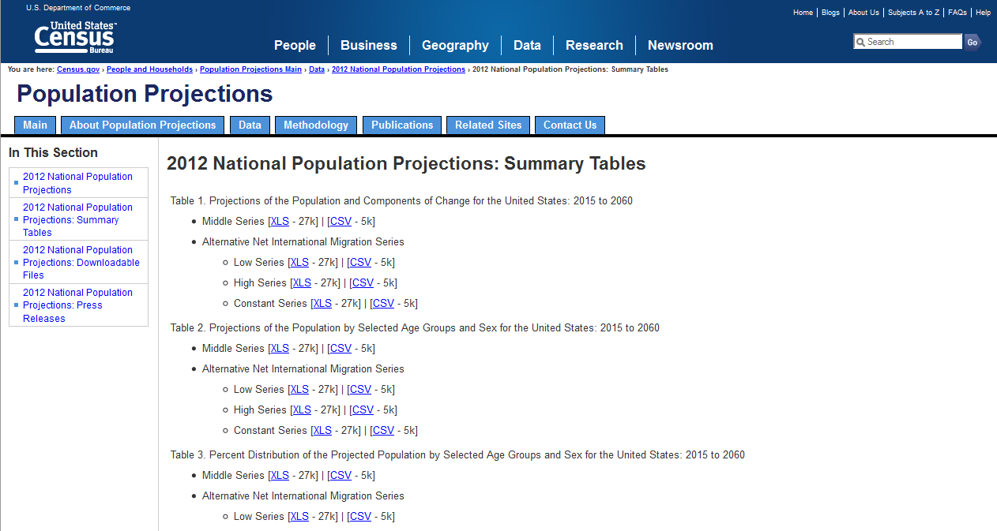
Click on the Excel link for Table 2, Middle Series. This has projections by age group.

Slide 24
Accessing the census website: http://www.census.gov
For addition assistance, you can ask a librarian
http://langsdale.ubalt.edu/research-help/

