Slide 1
PowerPoint
It doesn’t have to suck
Michael Shochet
Langsdale Library
mshochet@ubalt.edu
http://ubalt.libguides.com/powerpoint

Slide 2
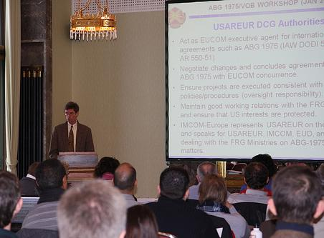
by USACE Europe District on Flickr
Notes:
Envision yourself giving a successful presentation. This is probably not the vision you had. You already know a lot of what not to do when designing presentations.

Slide 3
Notes:
Think of good presentations you have seen what made them good? They probably had an engaging speaker and offered a mix of modalities for delivering the message(i.e. using video, having in class exercises)

Slide 4
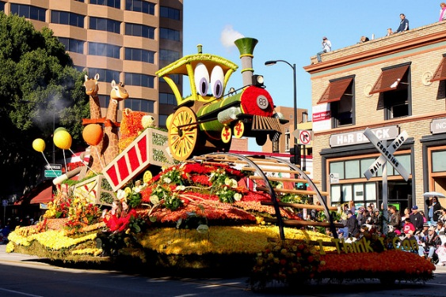
I Think I Can by Payitino on Flickr
Notes:
Daniel Pink, in To Sell is Human says that most effective way to psych yourself up is to tell yourself that “you can”, not that you will. Having knowledge of what your presentation could be, should give you confidence.

Slide 5
Presentations as Story
Design Principles for Slideware
Notes:
Things Americans are most scared of: #2 Death, #1 Speaking in public Presentations are an opportunity to change people’s minds and behaviors, and thus are important

Slide 6
information + storytelling
=
presentation
Notes:
Nancy Duarte points out that a presentation combines elements of information with storytelling.
Reports convey information
Stories produce an experience
Most people are more comfortable with the information part, but the story part gives us trouble.

Slide 7
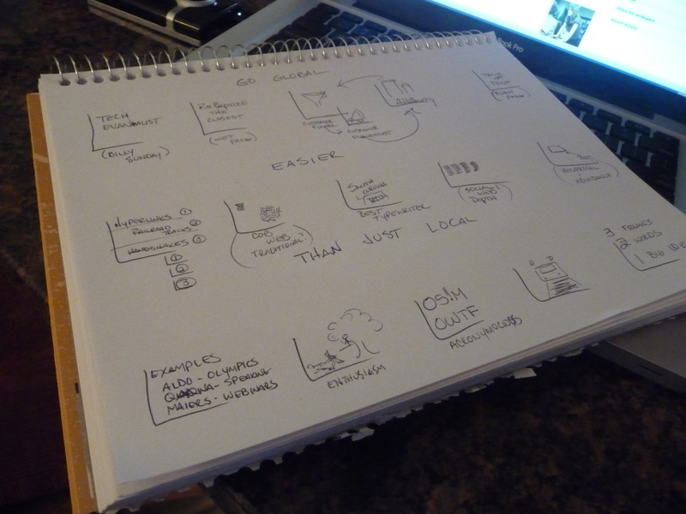
Story
Storyboard drafted by Mike Sansone on Flikr
Notes:
So, what should the story of your presentation look like.

Slide 8
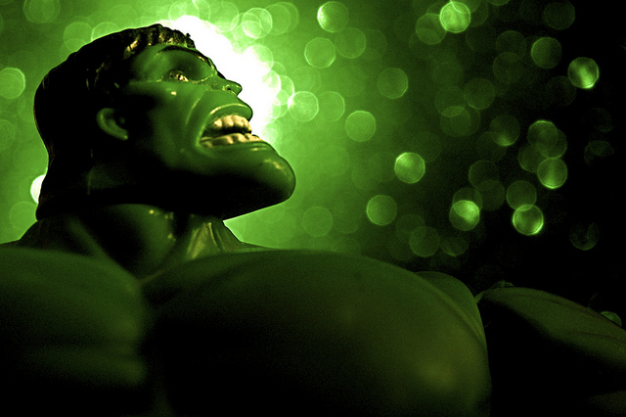
Hero’s Journey
End
Middle
Beginning
Incredible Transformation by JD Hancock on Flickr
Notes:
Nancy Duarte suggests that you use the Hero’s journey as a template for your presentation. It has a beginning, middle and end, barriers to overcome, and the hero emerges transformed in the end.

Slide 9
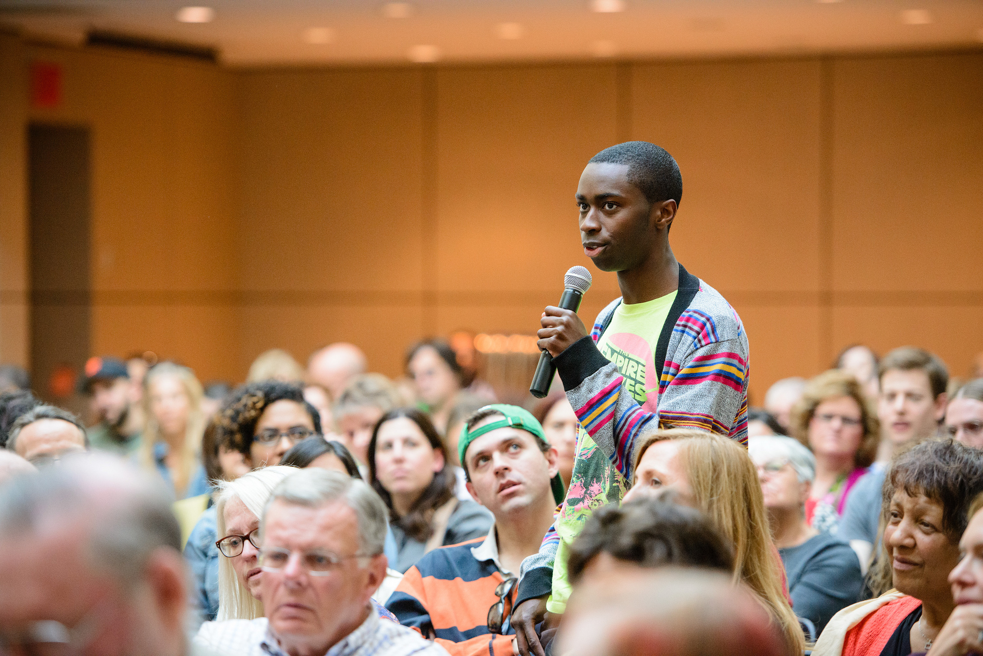
TTL_Studios-Michael_Moore-2356 by Montclaire ilm Festival on Flickr
Notes:
Who is the hero of your story?

Slide 10
Captain Underpants by Mfer Photography on Flickr
Notes:
Who is the hero of your story?

Slide 11
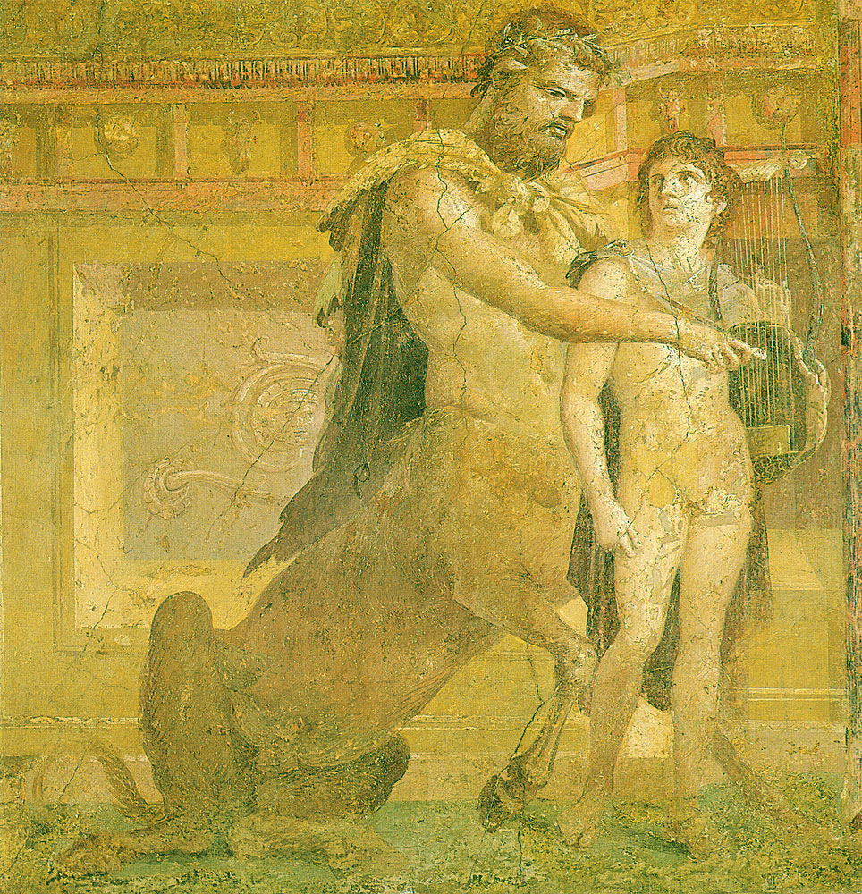
Achilles is taught to play the lyre by Chiron. Imperial Roman Fourth Style fresco from the Basilica at Herculaneum. Museo Nazionale, Naples
Notes:
If the audience is a hero, you as the presenter, take the role of mentor.

Slide 12
The Mentor’s Role
1. Ordinary world
2. The call to adventure
3. Refusal of the call
4. Meeting with the mentor
5. Crossing the threshold
6. Tests, allies and enemies
7. Approach
8. The ordeal
9. The reward
10. The road back
11. The resurrection
12. Return with the elixir
Notes:
Nancy Duarte suggests that you use the Hero’s journey as a template for your presentation. It has a beginning, middle and end, barriers to overcome, and the hero emerges transformed in the end.

Slide 13
Tension in the Hero's Journey
1. Ordinary world
2. The call to adventure
3. Refusal of the call
4. Meeting with the mentor
5. Crossing the threshold
6. Tests, allies and enemies
7. Approach
8. The ordeal
9. The reward
10. The road back
11. The resurrection
12. Return with the elixir
Notes:
Nancy Duarte suggests that you use the Hero’s journey as a template for your presentation. It has a beginning, middle and end, barriers to overcome, and the hero emerges transformed in the end.

Slide 14
Way things are vs.
Way things Could Be
1. Ordinary world
2. The call to adventure
3. Refusal of the call
4. Meeting with the mentor
5. Crossing the threshold
6. Tests, allies and enemies
7. Approach
8. The ordeal
9. The reward
10. The road back
11. The resurrection
12. Return with the elixir
Notes:
Nancy Duarte suggests that you use the Hero’s journey as a template for your presentation. It has a beginning, middle and end, barriers to overcome, and the hero emerges transformed in the end.

Slide 15
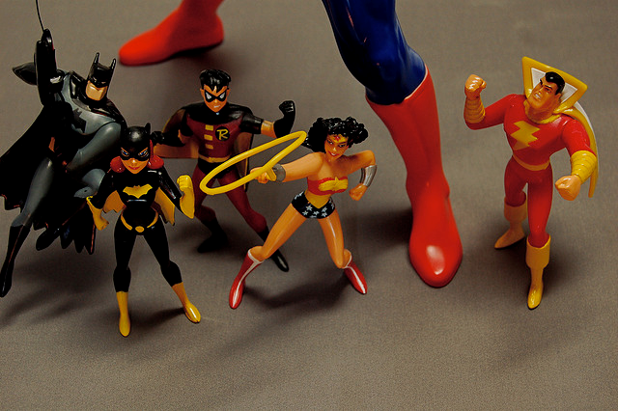
Call To Action
Super-Sized by JD Hancock on Flickr
Notes:
Nancy Duarte suggests that you use the Hero’s journey as a template for your presentation. It has a beginning, middle and end, barriers to overcome, and the hero emerges transformed in the end.

Slide 16
Know thy audience(s)
Doers
Suppliers
Influencers
Innovators
Audience of the Open Ocean by David Goehring on Flickr
Notes:
Know thy audience

Slide 17
Inspiration by Hartwig HKD on Flickr

Slide 18
Notes:
Try to get audience (hero) up to the threshold acknowledge the problem and give them advice as to what the future could be like once they cross the threshold.

Slide 19
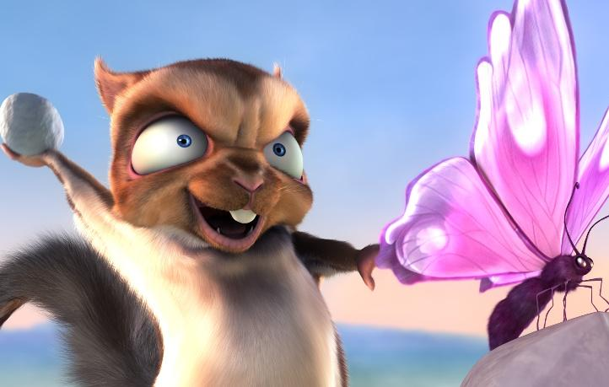
(c) copyright Blender Foundation
www.bigbuckbunny.org
Do No Harm
Notes:
This is an overriding principle. PowerPoint is a tool you can use to enhance a presentation. You don’t need it, you can choose to use it if it helps.

Slide 20
Rose petals on snow Are made brighter by contrast Please, no spinny things.
- Lynda Del Genis
Kalte Hände , Warme Liebe ..... by *Lie on Flickr
Notes:
Working within strict guidelines can help the presenter focus on what really matters

Slide 21
One point
buddha bokeh by Loving Earth on Flickr
Notes:
Try to place text, so it works with the picture. People will look at the image first, so you want the picture to lead the audience’s eyes to your text.

Slide 22
slides
handout
Notes:
This approach means that your slideshow is not a handout. You won’t have enough detail in your slides for them to stand on their own. Although you might be able to pull it off with a liberal use of the notes field.

Slide 23
Consciously
Use Whitespace
Notes:
To avoid clutter. Clutter adds noise, reduces clarity and makes slide hard to read and follow. Even a template design can add clutter.

Slide 24
Consciously
Use Whitespace
Notes:
Even a standard template introduces unnecessary clutter

Slide 25
Fonts:
Keep it in the Family
Family in Arizona after sundown by pyrat wesly on Flickr
Notes:
Choose one font and only use fonts from a single font family. You cam emphasize things using bold, italics, etc.

Slide 26
Serif
Sans-Serif
Yin + Yang by h.koppdelaney on Flickr
Notes:
You can use an additional font for accent/emphasis, but make sure you do NOT use 2 serif or 2 sans-serif fonts. Whichever “type” is your primary, use the other for accent.

Slide 27
Make it BIG
Notes:
You can use an additional font for accent/emphasis, but make sure you do NOT use 2 serif or 2 sans-serif fonts. Whichever “type” is your primary, use the other for accent.

Slide 28
Rainbow by
jakerome on Flickr
Notes:
Choose a simple color scheme and stick with it.

Slide 29
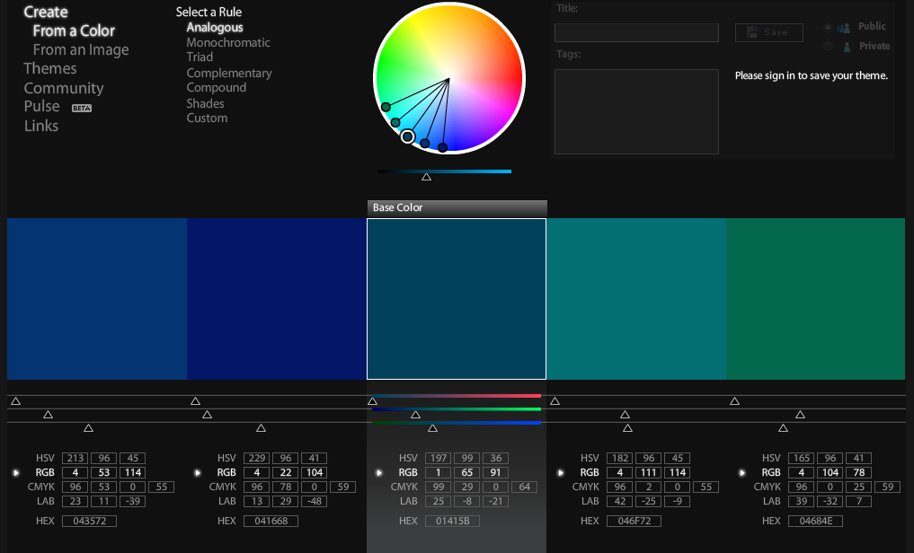
Color http://kuler.adobe.com/

Slide 30
Monochrome
with one Color

Slide 31
Images
Notes:
There is evidence that images related to your point makes them easier to remember

Slide 32
One Point
buddha bokeh by Loving Earth on Flickr
Notes:
A smaller image is less powerful

Slide 33
One point
buddha bokeh by Loving Earth on Flickr
Notes:
Try to place text, so it works with the picture. People will look at the image first, so you want the picture to lead the audience’s eyes to your text.

Slide 34
Readability
buddha bokeh by Loving Earth on Flickr
Notes:
This is hard to read on the photo background

Slide 35
Readability
buddha bokeh by Loving Earth on Flickr
Notes:
Having a solid color background helps the text be readable.

Slide 36
Rose petals on snow Are made brighter by contrast Please, no spinny things.
- Lynda Del Genis
Kalte Hände , Warme Liebe ..... by *Lie on Flickr
Notes:
Working within strict guidelines can help the presenter focus on what really matters

Slide 37
Charts, Graphs and Statistics

Slide 38
Book Sales in February 2011
In millions of dollars

Slide 39
E-Books accounted for almost 30% of February 2001 Book Sales
Children/
YA
E-Books
Adult

Slide 40
Book Sales
In millions of dollars
Source:
American Publisher's Association

Slide 41
Sales of printed books have flattened
In millions of dollars
Source:
American Publisher's Association

Slide 42
Sales of e-books have skyrocketed
In millions of dollars
In millions of dollars
Source:
American Publisher's Association

Slide 43
Finding Images
Notes:
Creative Commons licenses often allow for non-commercial use. Flickr has a creative commons search. US Government photos are free from copyright as are photographs before 1923. Do not use clip art.

Slide 44
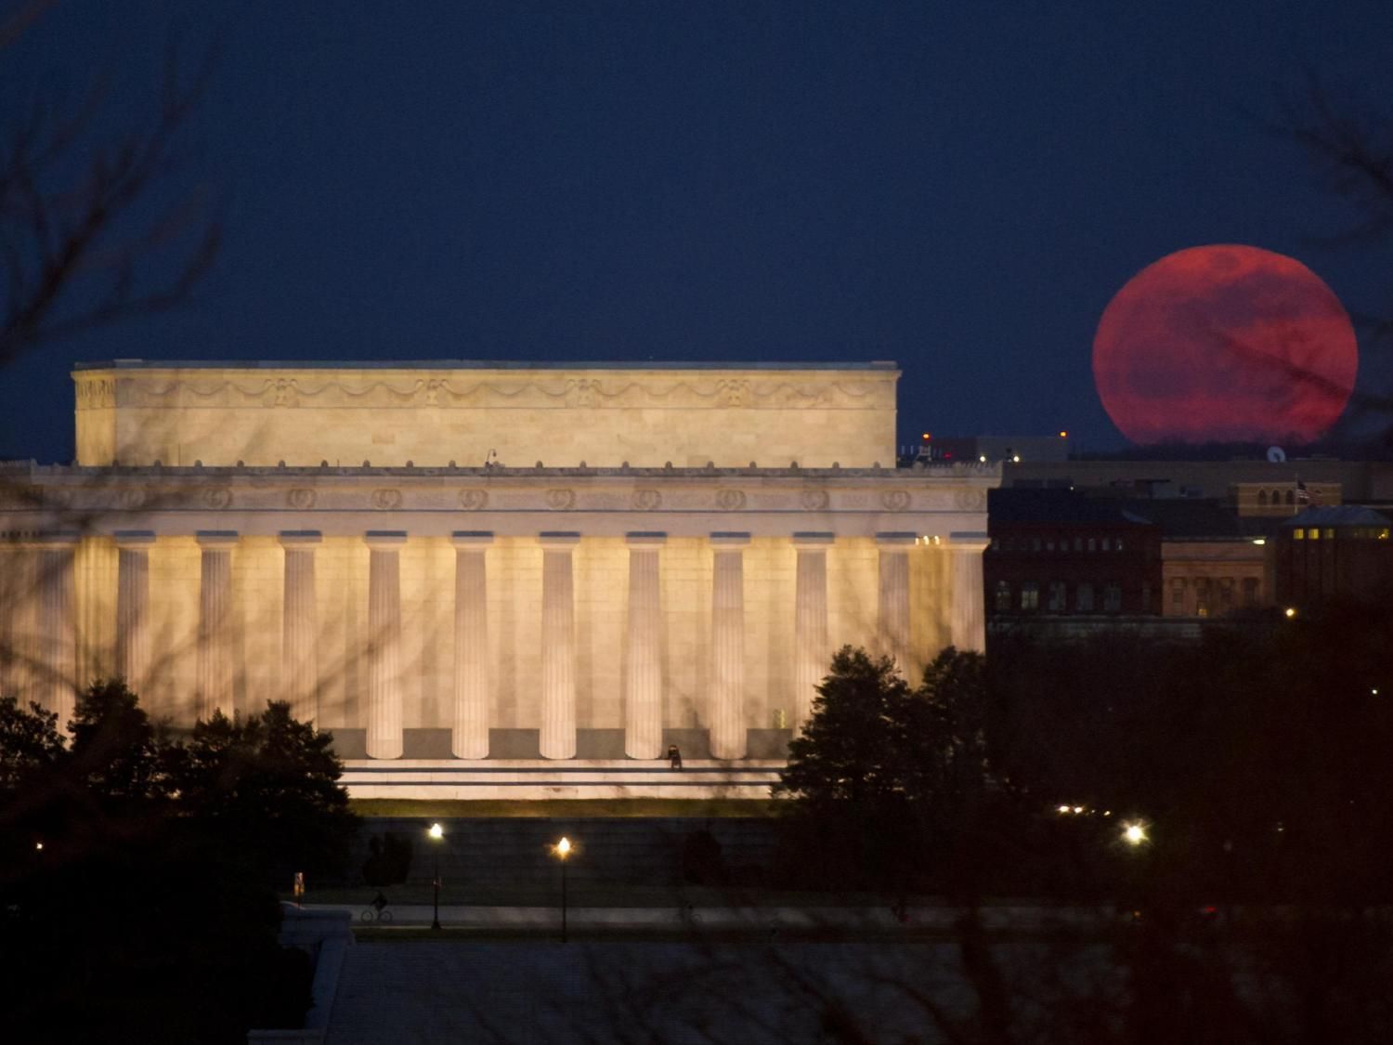
Public Domain
Notes:
Works in the public domain include those produced by the U.S. government and its employees in their official capacity. So official photos from NASA websites and the National Park Service website are in the public domain. Also, any pictures taken before 1923 are in the public domain, since the copyright on them has expired.

Slide 45
Notes:
People can choose to put a creative commons license on their work, which often allows for noncommercial use if attribution is given.

Slide 46
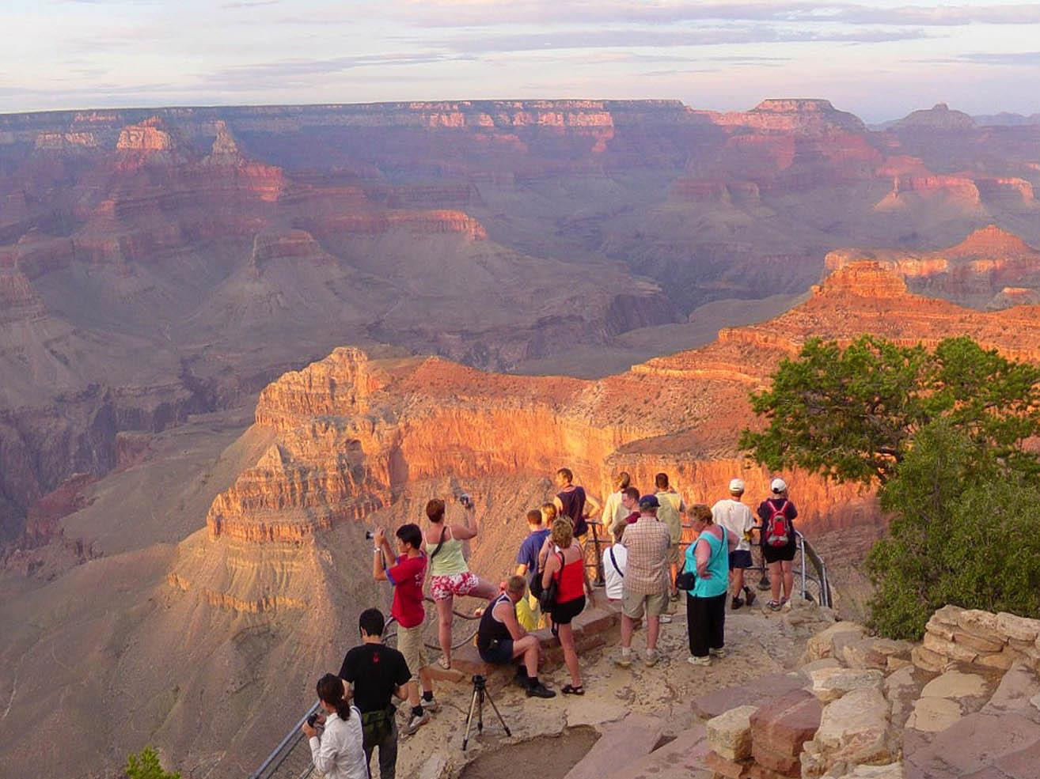
take your own

Slide 47
storyboard
Storyboard drafted by Mike Sansone on Flikr

Slide 48
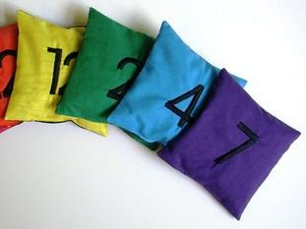
Count and Spell Color Recognition Beanbags – NUMBERS by EraPhernalia Vintage on Flickr
Choose
Color + Font

Slide 49
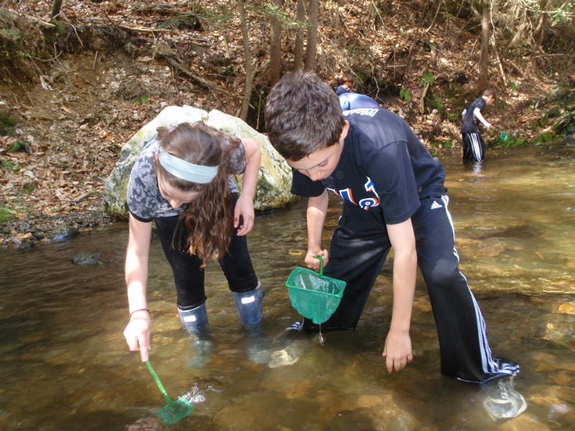
Find Images
Searching for macroinvertebrates by the Horace Mann School on Picassa
Notes:
Searching using the library databases will help you find more reliable and academically rigorous material.

Slide 50
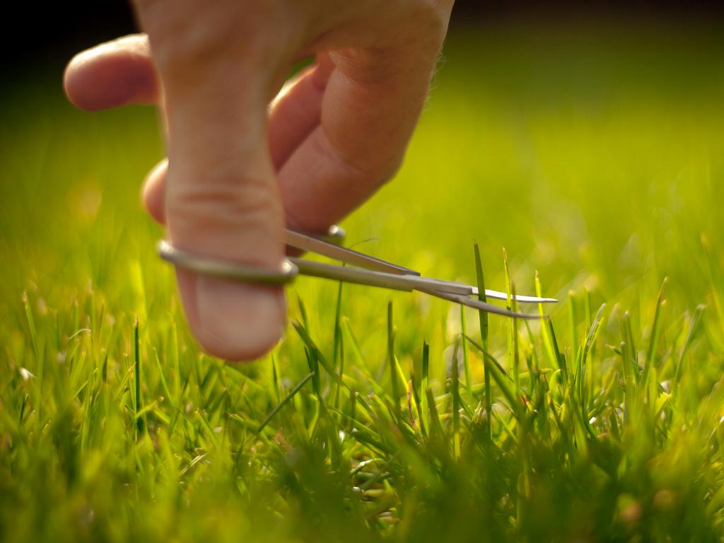
Remove Excess
Some people say I am obsessed with my lawn by Jez Page on Flickr

Slide 51
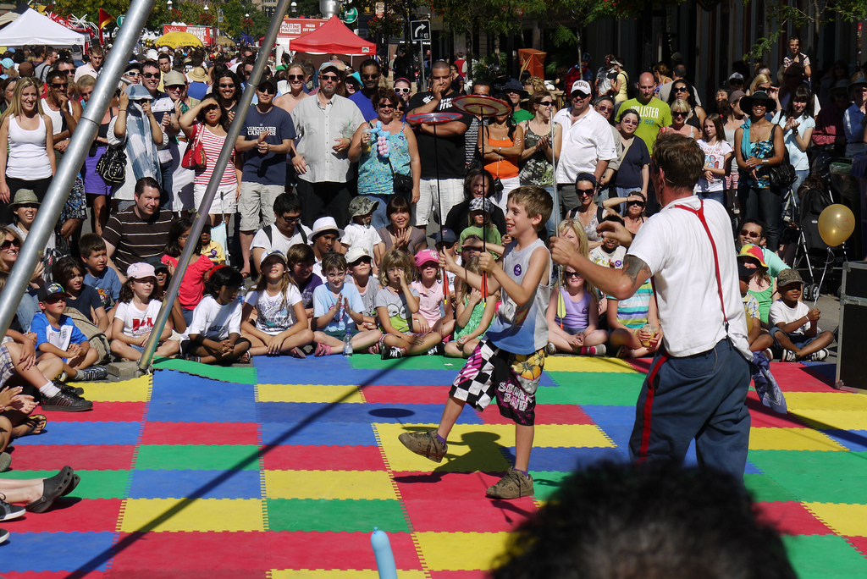
Audience Participation by ActiveSteve on Flickr

Slide 52
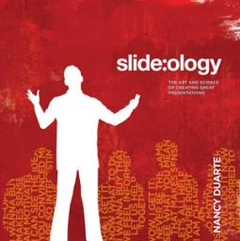
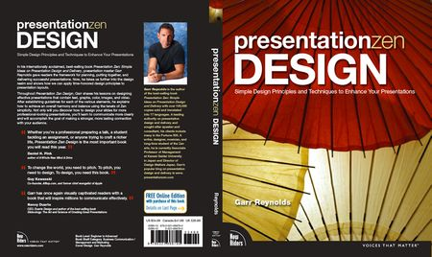
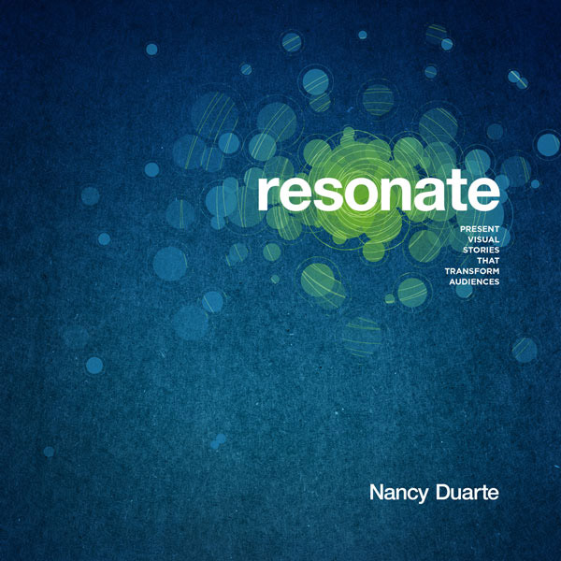
http://ubalt.libguides.com/powerpoint

