Slide 1
PowerPoint
It doesn’t have to suck
Michael Shochet
Langsdale Library
mshochet@ubalt.edu
http://ubalt.libguides.com/powerpoint

Slide 2
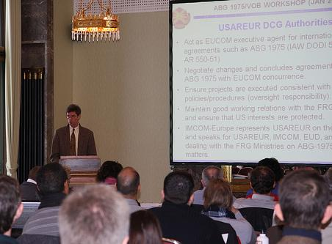
by USACE Europe District on Flickr
Notes:
In the beginning, PowerPoint was a means for Sales and Engineering to communicate.
It was a quick and easy way to make slides to display and could also be handed out. It also made some things, like animations, too easy.
Unfortunately, as you probably already know, PowerPoint makes it very easy to create a boring presentation.

Slide 3
Evil

Slide 4
“Step Right Up” by Telstar Logistics on Flickr
Notes:
As Tufte says, PowerPoint turns everything into a sales pitch

Slide 5
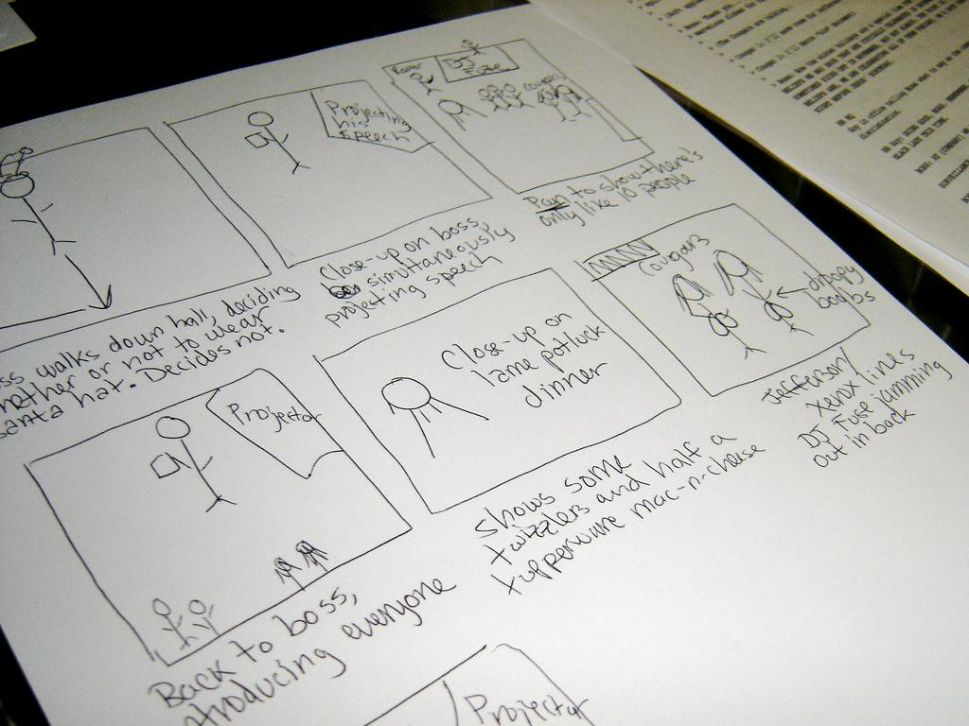
storytelling
Storyboard by ekai on Flikr

Slide 6
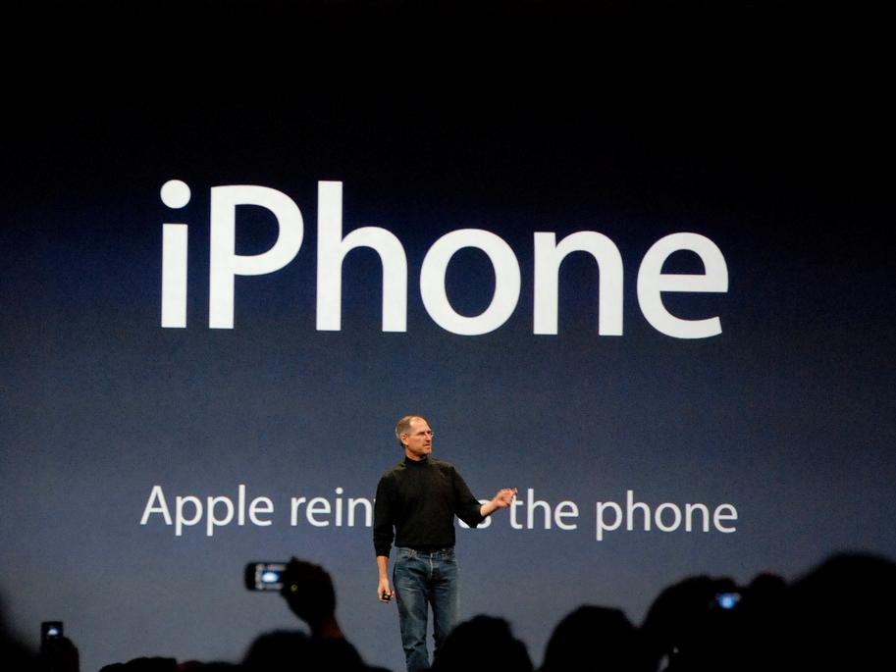
Img0061 by blakespot on Flickr
Notes:
Think of good presentations you have seen what made them good? They probably had an engaging speaker and offered a mix of of modalities for delivering the message(i.e. using video, having in class exercises)

Slide 8
Notes:
Programs like pecha kucha put restrictions on presentations (20 slides, 20 seconds per slide) and often wind up with better presentations. Why is this?

Slide 9
Rose petals on snow Are made brighter by contrast Please, no spinny things. - Lynda Del Genis
Kalte Hände , Warme Liebe ..... by *Lie on Flickr
Notes:
Working within strict guidelines can help the presenter focus on what really matters

Slide 10
Simplification
Notes:
What we learn from this is that Simplification is the key to a good powerpoint. Simplification is not simple. It is the stripping out or removing of anything that is unnecessary

Slide 11
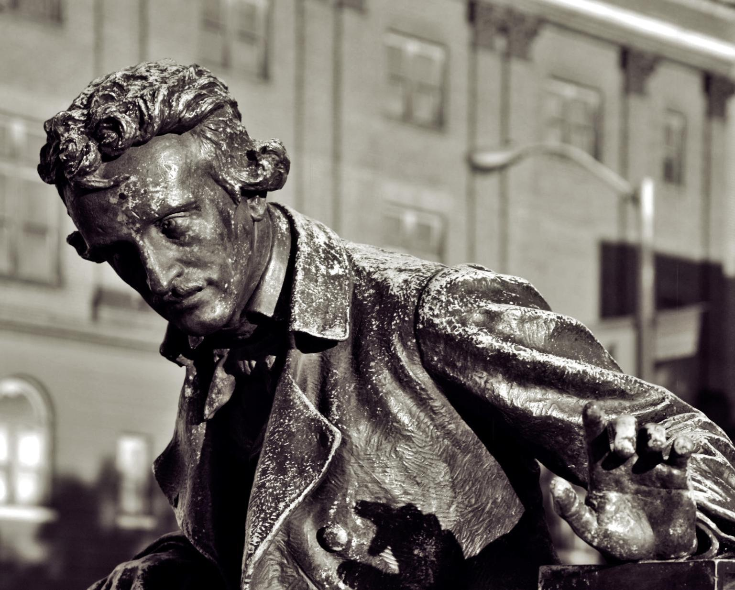
In the whole composition there should be no word written not to the , of which the tendency, direct or indirect, is one pre-established design.
Edgar Allen Poe
pondering poe..... by dcJohn on Flickr
Pondering Poe by dcJohn on Flickr
Notes:
Everything in your slide should reinforce your point. If it does not, take it out.

Slide 12
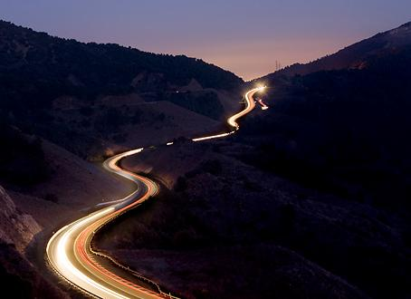
Exercise Restraint
Remove
anything unnecessary
Notes:
As you make your slides, exercise restraint. Once you are done, go back and remove anything that is unneeded.

Slide 13
slides
handout
Notes:
This approach means that your slideshow is not a handout. You won’t have enough detail in your slides for them to stand on their own. Although you might be able to pull it off with a liberal use of the notes field.

Slide 14
www.technicallyfunny.com
Notes:
Life after death by powerpoint

Slide 15
Consciously
Use Whitespace
Notes:
To avoid clutter. Clutter adds noise, reduces clarity and makes slide hard to read and follow. Even a half decent template design can add clutter.

Slide 16
Consciously
Use Whitespace
Notes:
Even a standard template introduces unnecessary clutter

Slide 17
Notes:
How do you get there in practice. You want to avoid clutter by using whitespace and simplifying all of your design choices, including the use of fonts, color. By the way, don’t be afraid to use a blank slide.

Slide 18
One Point
buddha bokeh by Loving Earth on Flickr
Notes:
Each slide should make one point and focus on just that slide.

Slide 19
fonts
Notes:
Practicle suggestions for fonts, colors and use of images

Slide 20
Keep it in the Family
Family in Arizona after sundown by pyrat wesly on Flickr
Notes:
Choose one font and only use fonts from a single font family. You cam emphasize things using bold, italics, etc.

Slide 21
Serif
Sans-Serif
Yin + Yang by h.koppdelaney on Flickr
Notes:
You can use an additional font for accent/emphasis, but make sure you do NOT use 2 serif or 2 sans-serif fonts. Whichever “type” is your primary, use the other for accent.

Slide 22
Make it BIG
Notes:
You can use an additional font for accent/emphasis, but make sure you do NOT use 2 serif or 2 sans-serif fonts. Whichever “type” is your primary, use the other for accent.

Slide 23
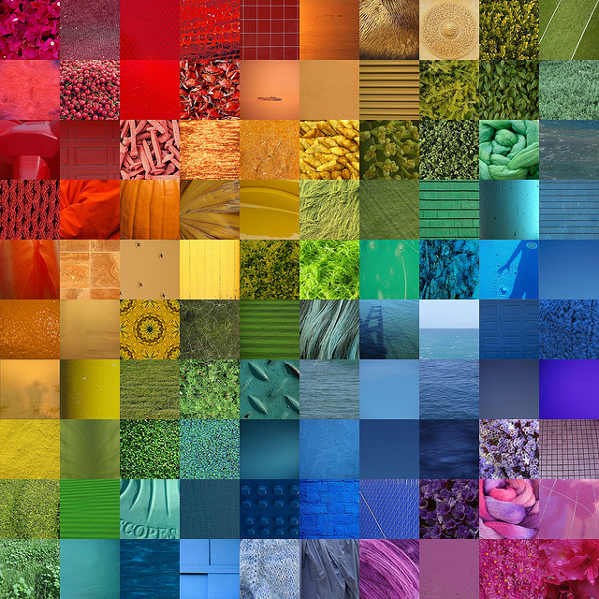
Rainbow by
jakerome on Flickr
Notes:
Choose a simple color scheme and stick with it.

Slide 24
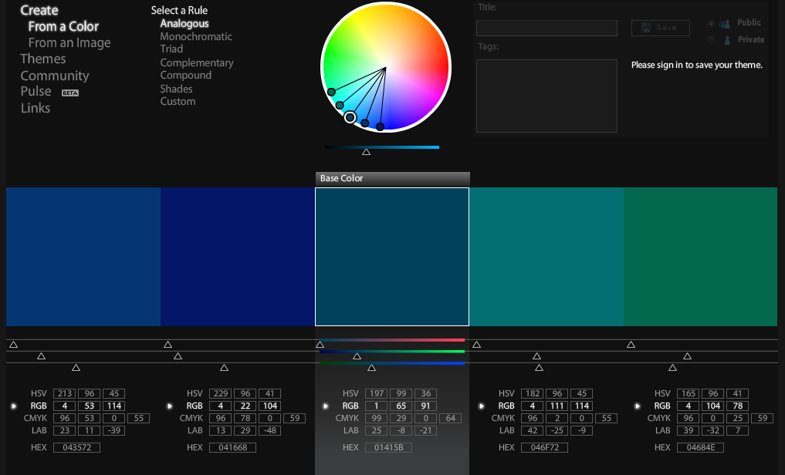
Analogous http://kuler.adobe.com/

Slide 25
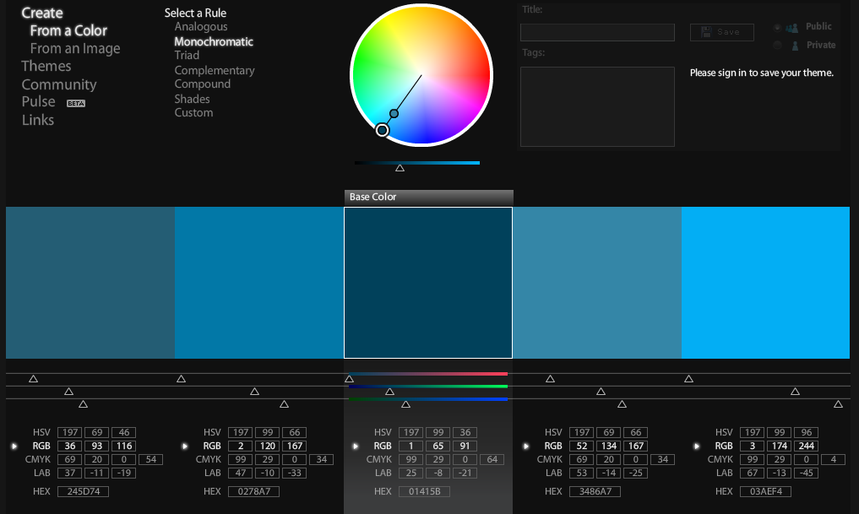
Monocromatic http://kuler.adobe.com/

Slide 26
Monochrome
with one Color

Slide 27
Images
Notes:
There is evidence that images related to your point makes them easier to remember

Slide 28
One point
buddha bokeh by Loving Earth on Flickr
Notes:
A picture that covers the entire frame will usually be more powerful. Also, the audience will often be drawn to the picture, so you want to the picture to draw people’s eyes to the text.

Slide 29
One Point
buddha bokeh by Loving Earth on Flickr
Notes:
A smaller image is less powerful

Slide 30
One point
buddha bokeh by Loving Earth on Flickr
Notes:
Try to place text, so it works with the picture. People will look at the image first, so you want the picture to lead the audience’s eyes to your text.

Slide 31
One point
buddha bokeh by Loving Earth on Flickr
Notes:
Not here

Slide 32
One point
Notes:
Even worse

Slide 33
Rotation
buddha bokeh by Loving Earth on Flickr
Notes:
Rotating text can add interest in some circumstances.

Slide 34
Notes:
Life after death by powerpoint

Slide 35
Readability
buddha bokeh by Loving Earth on Flickr
Notes:
This is hard to read on the photo background

Slide 36
Readability
buddha bokeh by Loving Earth on Flickr
Notes:
Having a solid color background helps the text be readable.

Slide 37
(c) copyright Blender Foundation
www.bigbuckbunny.org
Semi- Transparent Backgrounds
Notes:
You can make the text background semi-transparent if you want the image to show through, but still have the text readable.

Slide 38
Finding Images
Notes:
Creative Commons licenses often allow for non-commercial use. Flickr has a creative commons search. US Government photos are free from copyright as are photographs before 1923. Do not use clip art.

Slide 39
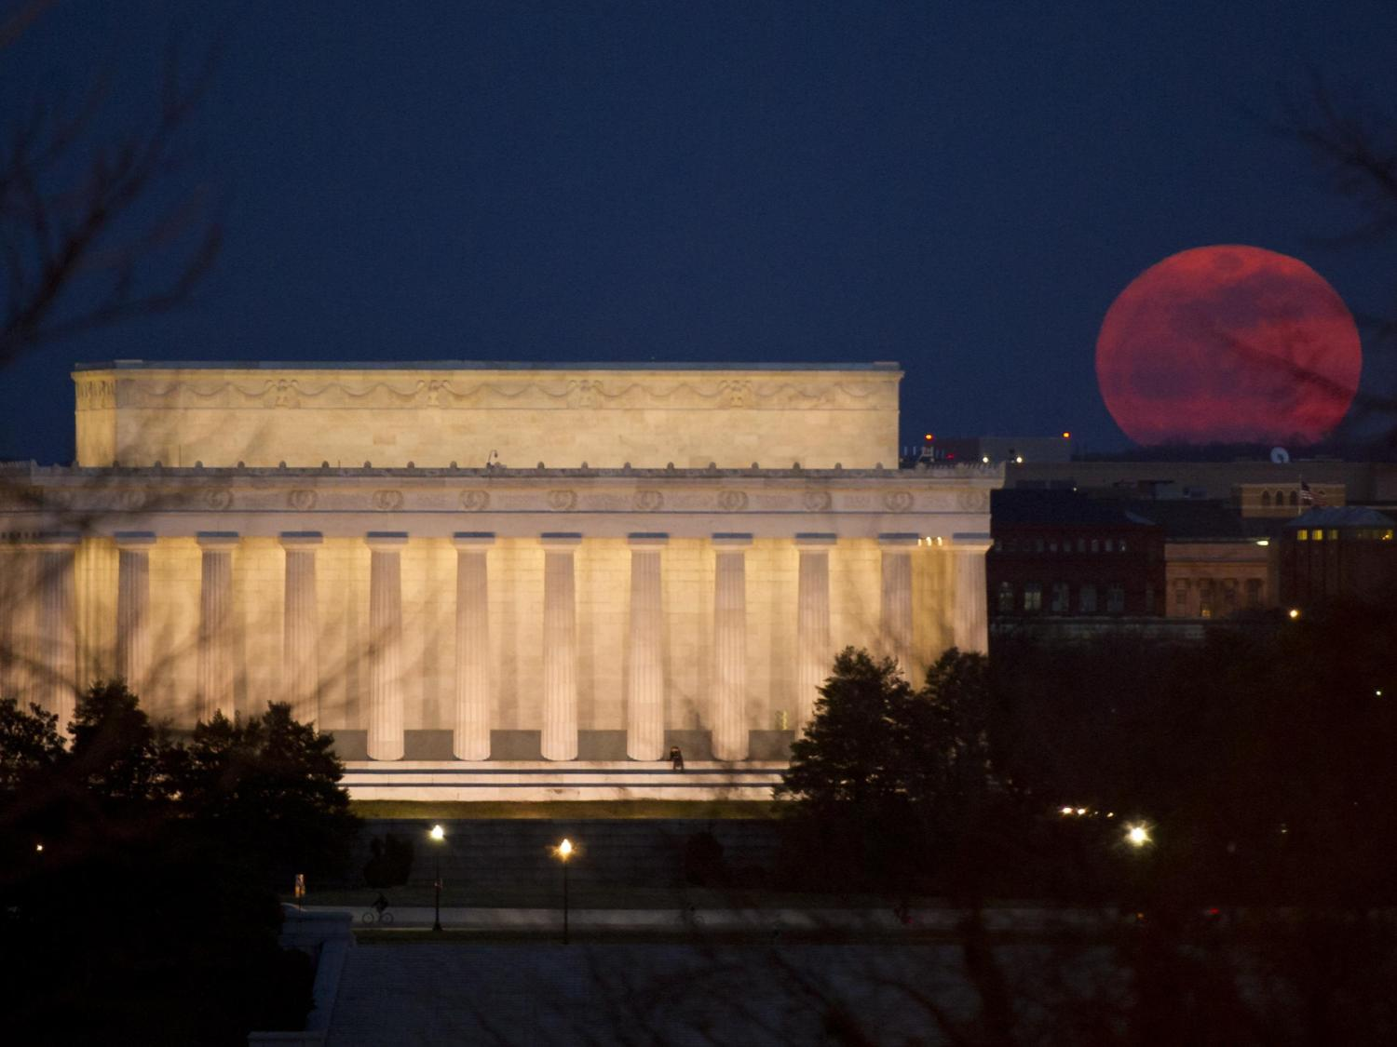
Public Domain
Notes:
Works in the public domain include those produced by the U.S. government and its employees in their official capacity. So official photos from NASA websites and the National Park Service website are in the public domain. Also, any pictures taken before 1923 are in the public domain, since the copyright on them has expired.

Slide 40
Notes:
People can choose to put a creative commons license on their work, which often allows for noncommercial use if attribution is given.

Slide 41
Flickr: Creative Commons
Notes:
Flickr has a Creative Commons filter. You can sometimes get better photos from Flickr by sorting your results by “interestingness” instead of relevance.

Slide 42
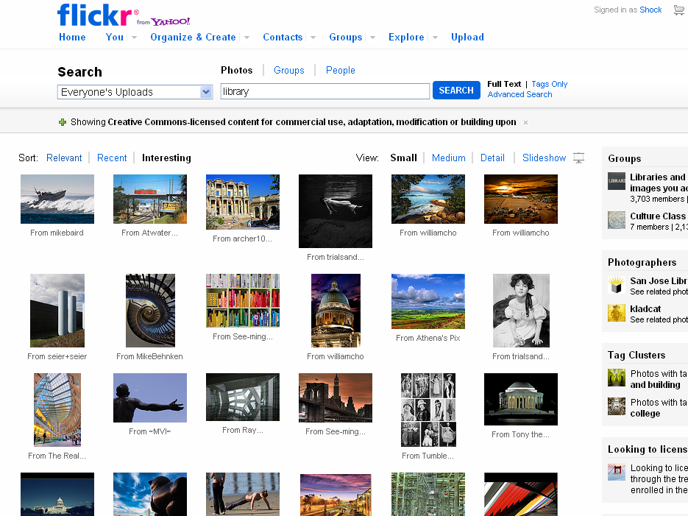

Slide 43
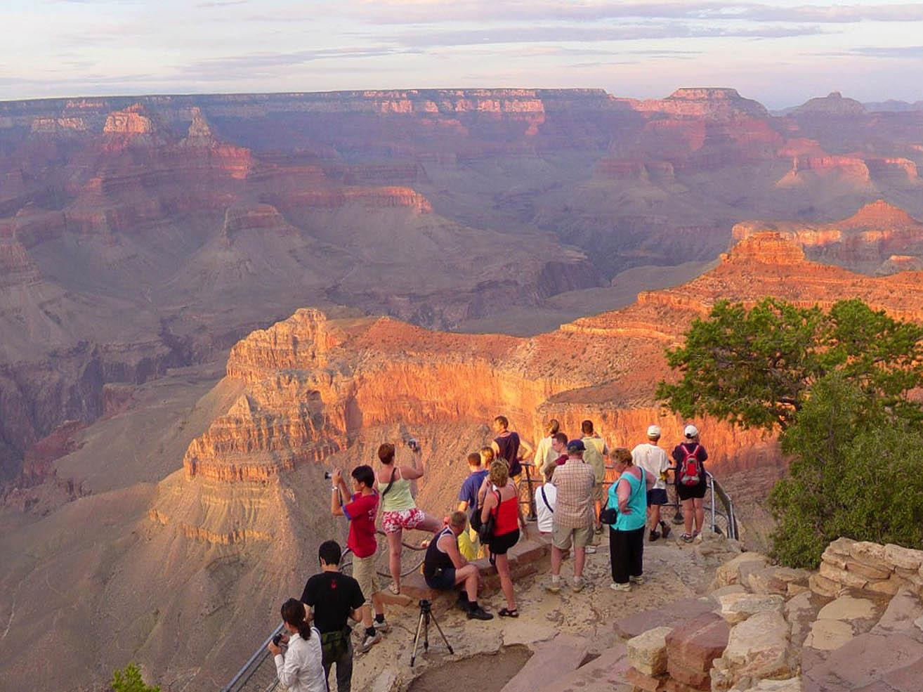
take your own

Slide 44
Use the Right Data
Use the Right Chart

Slide 45
Books Sales Per Year
(in millions of dollars)
Year | E-Books | Print Books
2002 | 2.1 | 3,897.7
2003 | 6.0 | 3,835.3
2004 | 9.3 | 3,794.7
2005 | 16 | 5,058.5
2006 | 25.2 | 5,036.4
2007 | 31.7 | 5,457.9
2008 | 61.3 | 5,158
2009 | 169.5 | 5,127.1
2010 | 441.3 | 4,864.0
Source:
American Publisher's Association

Slide 46
E-Book Sales have doubled in each of the past 3 years.
Sales in millions of dollars
Year | E-Books
2005 | 16
2006 | 25.2
2007 | 31.7
2008 | 61.3
2009 | 169.5
2010 | 441.3
Source:
American Publisher's Association

Slide 47
Book Sales
In millions of dollars
Source:
American Publisher's Association

Slide 48
E-Book account for an increasingly large percentage of book sales.
Source:
American Publisher's Association

Slide 49
One point
buddha bokeh by Loving Earth on Flickr
Notes:
Try to place text, so it works with the picture. People will look at the image first, so you want the picture to lead the audience’s eyes to your text.

Slide 50
Book Sales
In millions of dollars
Source:
American Publisher's Association

Slide 51
Sales of printed books have flattened
In millions of dollars
Source:
American Publisher's Association

Slide 52
Sales of e-books have skyrocketed
In millions of dollars
Source:
American Publisher's Association

Slide 53
Book Sales in February 2011
In millions of dollars

Slide 54
E-Books accounted for almost 30% of February 2011 Book Sales
Children/
YA
E-Books
Adult

Slide 55
E-Book account for an increasingly large percentage of book sales.
Source:
American Publisher's Association

Slide 56
Feb 2011:
30%
ebook by teclasorg on Flickr

Slide 57
storyboard
Storyboard by ekai on Flikr

Slide 58
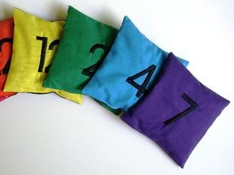
Count and Spell Color Recognition Beanbags – NUMBERS by EraPhernalia Vintage on Flickr
Choose
Color + Font

Slide 59
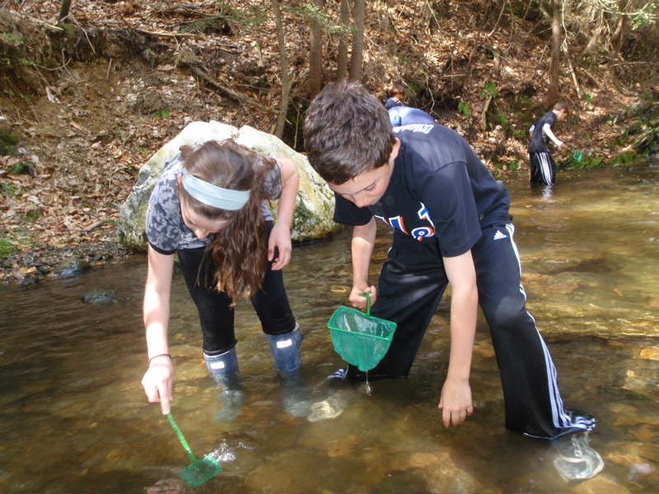
Find Images
Searching for macroinvertebrates by the Horace Mann School on Picassa
Notes:
Searching using the library databases will help you find more reliable and academically rigorous material.

Slide 60
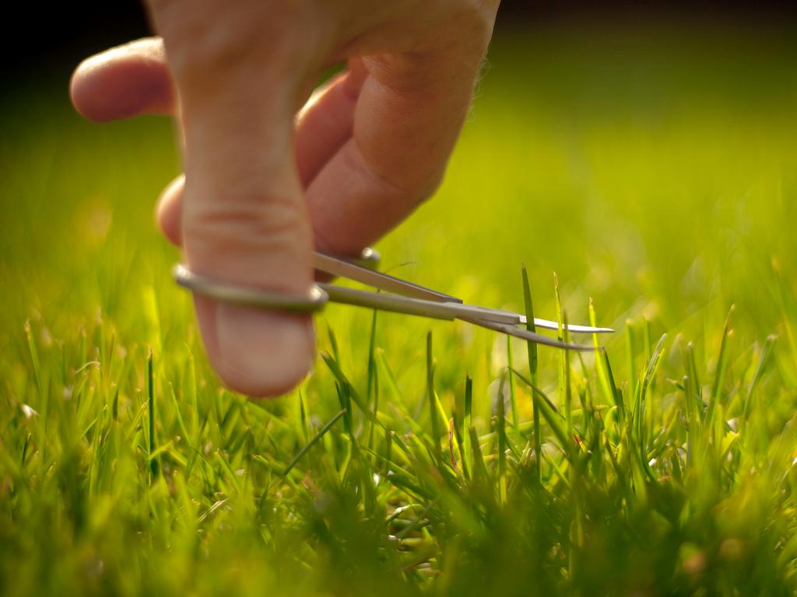
Remove Excess
Some people say I am obsessed with my lawn by Jez Page on Flickr

Slide 61
Hands in the air - in concert by ` marfis75 on Flickr

Slide 62
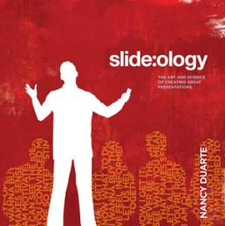
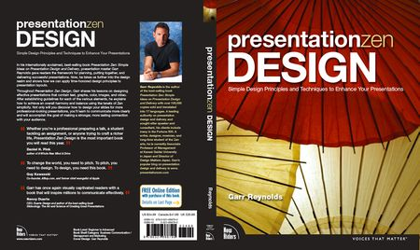
http://ubalt.libguides.com/powerpoint
Hands in the air - in concert by ` marfis75 on Flickr

