Slide 2
Trait Approach
Chapter 2

Slide 3
Overview
Great Person Theories
Historical Shifts in Trait Perspective
What Traits Differentiate Leaders From Nonleaders?
How Does the Trait Approach Work?

Slide 4
Great Person Theories
Trait Approach: One of the first systematic
attempts to study leadership
“Great Man” Theories (early 1900s)
  Focused on identifying innate qualities and characteristics possessed by great social, political, and military leaders

Slide 5
Historical Shifts in Trait Perspective
Early 1900s
1930-50s
1970s - Early 90s
Today
Great Man Theories
Traits Interacting With
Situational Demands on Leaders
Revival of Critical Role of
Traits in Leader Effectiveness
5 Major
Leadership Traits
Research focused
on individual
characteristics
that universally
differentiated
leaders
from nonleaders
Landmark Stogdill (1948)
study - analyzed and
synthesized 124 trait studies
- Leadership
reconceptualized
as a relationship between
people in a social situation
Mann (1959) reviewed 1,400
findings of personality and
leadership in small groups
- Less emphasis on situations
- Suggested personality traits
could be used to discriminate
leaders from nonleaders
Stogdill (1974)
- Analyzed 163 new studies
with 1948 study findings
- Validated original study
- 10 characteristics
positively identified with
leadership
Lord, DeVader, & Alliger
(1986) meta-analysis
- Personality traits can be
used to differentiate
leaders/nonleaders
Kirkpatrick & Locke (1991)
- 6 traits make up the
“Right Stuff” for leaders
Intelligence
Self-Confidence
Determination
Integrity
Sociability
Innate Qualities
Situations
Personality / Behaviors

Slide 6
Major Leadership Traits
Traits to possess or cultivate if one seeks to be
perceived by others as a leader:
Intelligence--Verbal, perceptual, and reasoning capabilities. For example, Steve Jobs
Self-Confidence--Certainty about one’s competencies and skills. For example, Steve Jobs
Determination--Desire to get the job done (i.e., initiative, persistence, drive). For example, Dr. Paul Farmer

Slide 7
Major Leadership Traits
Traits to possess or cultivate if one seeks to be
perceived by others as a leader:
Integrity--The quality of honesty and trustworthiness. For example, Character Counts! program
Sociability--Leader’s inclination to seek out pleasant social relationships. For example, Michael Hughes, university president

Slide 8
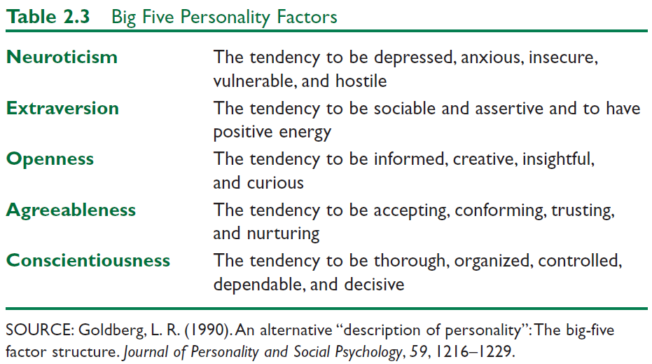
Five-Factor Personality Model and Leadership

Slide 9
Five-Factor Personality Model and Leadership
Big Five and Leadership Study Using Meta-Analysis
(Judge et al, 2002)
RESULTS--a strong relationship between personality traits and leadership
Extraversion--factor most strongly associated with leadership
  Most important trait of effective leaders
Conscientiousness--Second most related factor with leadership; but highest correlation with overall job performance (Sacket & Walmsley, 2014)
Openness--next most related
Low Neuroticism
Agreeableness--only weakly related to leadership

Slide 10
Strengths and Leadership
Strengths are the ability to consistently demonstrate exceptional work. (Buckingham & Clifton, 2001; Rath, 2007)
Strengths come from having certain talents and then further developing those talents by gaining additional knowledge, skills, and practice.
Leadership capability is enhanced when we are able to discover our fully utilized strengths, underutilized strengths, and weaknesses. (MacKie , 2016)

Slide 11
Emotional Intelligence and Leadership
Definition
Underlying Premise
Ability to perceive and:
  apply emotions to life’s tasks
  reason/understand emotions
  express emotions
  use emotions to facilitate thinking
  manage emotions within oneself and relationships
people who are more sensitive to their emotions and their impact on others will be more effective leaders

Slide 12
Different Ways to Measure EQ
MSCEIT (2000): EQ as a set of mental abilities
  to perceive, facilitate, understand, and manage emotion
Goleman (1995, 1998): EQ as a set of personal and social competencies
self-awareness, confidence, self-regulation, conscientiousness, and motivation
Shankman and Allen (2015): EQ as awareness of three aspects of leadership
context, self, and others

Slide 13
How Does the Trait Approach Work?
Focus of trait approach
Strengths
Criticisms
Application

Slide 14
Focus of Trait Approach
Personality Assessments
Leader
Focuses exclusively on leader
  What traits leaders exhibit
  Who has these traits
Organizations use personality assessments to find the “right” people
  Assumption--will increase organizational effectiveness
  Specify characteristics/traits for specific positions
    Personality assessment measures for “fit”
    Instruments: LTQ, Myers Briggs

Slide 15
Strengths
Intuitively appealing
  Perception that leaders are different in that they possess special traits
  People “need” to view leaders as gifted
Credibility due to a century of research support
Highlights leadership component in the leadership process
  Deeper level understanding of how leader/personality related to leadership process
Provides benchmarks for what to look for in a leader

Slide 16
Criticisms
Fails to delimit a definitive list of leadership traits
  Endless lists have emerged
Doesn’t take into account situational effects
  Leaders in one situation may not be leaders in another situation
List of most important leadership traits is highly subjective
  Much subjective experience and observations serve as basis for identified leadership traits
Research fails to look at traits in relationship to leadership outcomes
Not useful for training and development

Slide 17
Application
Provides direction as to which traits are good to have if one aspires to a
leadership position
Through various tests and questionnaires, individuals can determine whether they have the select leadership traits and can pinpoint their strengths and weaknesses
Leadership Traits
Intelligence
Self-confidence
Determination
Integrity
Sociability
Can be used by managers to assess where they stand within their organization and what is needed to strengthen their position

