Slide 1
Personnel Selection
Neil H. Schwartz, Ph.D.
Psych 560

Slide 2
Introduction
Personnel psychology: the study and practice of:
Job analysis
Job recruitment
Employee selection
Evaluation of employee performance
Organizational psychology: the study of:
Leadership
Job satisfaction
Employee motivation
General functioning of organizations.

Slide 3
Personnel Psychology: Employee Selection: EMPLOYMENT INTERVIEWS
Research supports structured employment interviews in reaching agreement on employment decisions.
Structured interviews produce mean validity coefficients twice that of unstructured interviews.
Employment interviews search for negative rather than positive evidence of a person.
A single negative impression is followed by rejection 90% of the time, except when an early impression is favorable (then the rejection rate drops to 25%).

Slide 4
Making impressions in employment interviews
Negative factors include:
Poor communicaton skills
Lack of confidence or poise
Low enthusiasm
Nervousness
Failure to make eye contact
Positive factors include:
Ability to express oneself,
Self-confidence and poise
Enthusiasm
Ability to sell oneself
Aggressiveness
A good first impression is one of the most important factors
Wear professional attire with good grooming
Project an aura of competence and expertise
Give an impression of friendliness or personal warmth
Be natural without coming on strong– too much is perceived as manipulative.

Slide 5
Personnel Psychology: Employee Selection: BASE RATES & HIT RATES
The notion of base rates and hit rates come into play based on the use of tests to provide information about a person beyond what would be known about the person if the test was not used, and how accurate is the decision to accept or reject.
This is important because a person must be placed into one of two categories: selected or rejected.
High Score
Accept
Applicant
Cutting Score
Decision
Reject
Low Score

Slide 6
Personnel Psychology: Employee Selection: HIT RATES
Hit rate is the percentage of cases in which a test accurately predicts success or failure on those people selected and rejected.
Selection
Decision
Performance
Accept
Good job
Hit
Bad job
Miss
Decision
Reject
Good job
Miss
Bad job
Hit
Low Score
Cutting
Score
High Score
The applicant was accepted but did a bad job. This person is a
MISS.
Applicant
The goal in personnel selection is to maximize hits and minimize misses.

Slide 7
Personnel Psychology: Employee Selection: BASE RATES
Base rate is the percentage of cases in a population in which a particular characteristic occurs without the use of a test.
If the base rate is higher than the hit rate, then the use of a test for selection is unnecessary– unless the test is intended to make selections better than the base rate.
The key to effective testing for selection is to add information (or features) beyond what is known from the base rate.
If a test can add to the base rate, it is worth using.
Base Rate: 60% [60% of applicants not taking the MCAT would succeed in medical school.]
40% of applicants not taking the MCAT would fail in
medical school.
MCAT Hit Rate: 80% [80% of applicants exceeding a score of 30 succeed in medical school]
20% with a score of 30 or above fail in medical school.

Slide 8
Hits and Misses: Types of Misses
One type of miss is a FALSE NEGATIVE
A false negative is a miss where a test taker is rejected but would have done well.
Another type of miss is a FALSE POSITIVE
A false positive is a miss where a test taker is accepted but ended up doing poorly.
Both types of misses are considered errors in selection.
Both types of misses must be evaluated in terms of the costs of being wrong.
For example, what is the cost of being wrong in selecting:
Medical school applicants for admission?
Psychology graduate school applicants for admission?
Suicidal adolescents for treatment?
Prisoners convicted of murder for parole?
A patient for a delicate neurological procedure to remove a tumor?

Slide 9
Understanding Hits and Misses in terms of ACCURACY and DETECTION
Consider an expensive radiological procedure as a test.
The Procedure can be used to determine the presence of a brain tumor.
The example is the same as personnel selection:
That is, who should have the procedure done on them to determine if there is a tumor there?
And, what if the test misses the brain tumor?
Or, what if the test says that there is a brain tumor and the patient actually does not have one?
Hmm….

Slide 10
Understanding Hits and Misses in terms of ACCURACY and DETECTION
Example: 83% accuracy; 80% detection |  |  | Test Result
 |  | Brain Damage | Normal | Total
 | Brain Damage | 8 (A) | 2 (B) | 10 (A+B)
Actual | Normal | 15 (C) | 75 (D) | 90 (C+D)
 | Total | 23 | 77 | 100
A = Hit
B = False negative
C = False positive
D = Hit
A/(A+B) = detection rate
(sensitivity)
D/(C+D) = specificity base rate
(A+D)/A+B+C+D) = accuracy
rate
Example: 40% accuracy; 44% detection |  |  | Test Result
 |  | Brain Damage | Normal | Total
 | Brain Damage | 40 | 50 | 90
Actual | Normal | 10 | 0 | 10
 | Total | 50 | 50 | 100

Slide 11
Adding Test Validity to Selection
The decision to use a test for selection must depend on what the test offers.
A worthwhile test must provide more information than the base rate alone.
A test with high criterion-related validity (concurrent or predictive) provides more value in a selection decision than no test or a test with poor validity.
In order to determine a test’s contribution to the selection process, Taylor-Russell Tables are essential.

Slide 12
Using Taylor-Russell Tables: Part 1
Taylor-Russell tables allow you to evaluate the validity of a test relative to the amount of information it contributes beyond the base rate.
In order to use the Taylor-Russell table you must have the following information:
Definition of success
The way success is defined: e.g. success on a performance measure of the job; success on a performance measure in medical school; success must be defined dichotomously– either good or bad. Good = above cutoff; Bad = below cutoff.
Determination of base rate
The percentage of people who would succeed if there was not testing.
Definition of selection ratio
The percentage of applicants who are selected or admitted.
Determination of validity coefficient
The correlation between the test and the criterion of success.

Slide 13
Using Taylor-Russell Tables: Part 2
Proportion of Employees Considered Satisfactory = .20 (Base rate.)
There is a Taylor-Russell Table for each base rate.
Consider the tables below– one for BR = .20; the other for BR = .50:
The entries in the table are the proportion expected to be successful if you use the test.
Base Rate = .20 | Selection Ratio
Validity coefficient | .10 | .30 | .50 | .90
r = .00 | .20 | .20 | .20 | .20
r = .25 | .34 | .29 | .26 | .21
r = .50 | .52 | .38 | .31 | .22
r = .95 | .97 | .64 | .40 | .22
Base Rate = .50 | Selection Ratio
Validity coefficient | .10 | .30 | .50 | .90
r = .00 | .50 | .50 | .50 | .50
r = .25 | .67 | .62 | .58 | .52
r = .50 | .84 | .74 | .67 | .54
r = .95 | 1.00 | .99 | .90 | .56

Slide 14
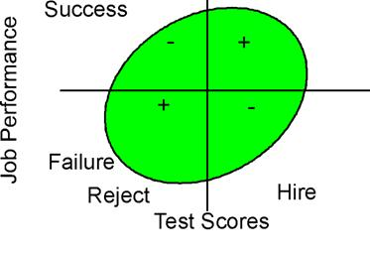
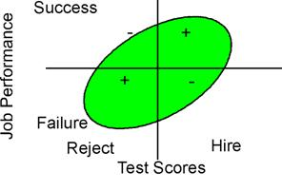
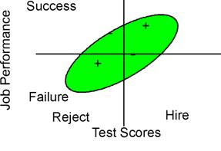
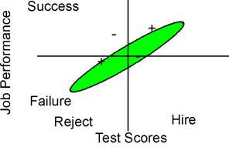
Understanding Decisions Based on Validity
Very Low Correlation
Low Correlation
High Correlation
Very High Correlation

Slide 15
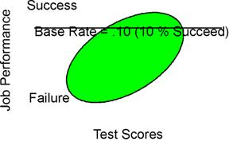
Understanding Decisions Based on Base Rate

Slide 16
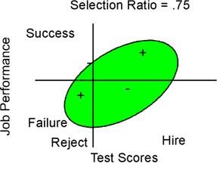
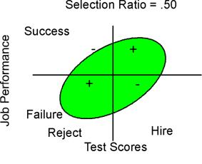
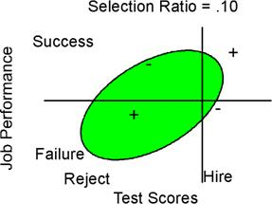
Understanding Decisions Based on Selection Ratio
Selection ratio. The selection ratio is the number hired divided by the number who applied. If 100 people apply and 50 are hired, the selection ratio is .5. If 100 people apply and 10 are hired, the selection ratio is .1. Suppose we assume that the top people (i.e., those who score highest on the test) will be selected. That is, if we are selecting 10 of 100, we will take the top 10 scorers. In general, other things being equal, the smaller the selection ratio, the more useful the test.

Slide 17
Considering Base Rate, Selection Ratio, and Test Validity Together
Proportion of Employees Considered Satisfactory = .20 (Base rate.)
When r = .00, using the test results in a success rate equal to the base rate, which is the same thing as not using the test. If there is no correlation between the test and success on the job, then using the test will not improve selection.
As the correlation gets larger, the success rates go up. For example, in the first column of entries in the first table, the base rate is .20, and the selection ratio is .10. When the correlation is .25, the proportion successful is .34, which is up .14 from .20. When the correlation is .50, the success rate is .52, which is up .32 from .20.
When the selection ratio is small, changes in the size of the correlation make a lot of difference in the success rate.
When the selection ratio is large, however, changes in the size of the correlation make little difference. For example, in the first table when the selection ratio is .9 and the correlation is .25, the expected success rate is .21, which is up .01 from .20. When we move from a correlation of .25 to a correlation of .95, the success rate goes from .21 to .22, which is not much. This happens because when the selection ratio is large, we basically have to hire anyone who applies; we cannot be selective.
Base Rate = .20 | Selection Ratio
Validity coefficient | .10 | .30 | .50 | .90
r = .00 | .20 | .20 | .20 | .20
r = .25 | .34 | .29 | .26 | .21
r = .50 | .52 | .38 | .31 | .22
r = .95 | .97 | .64 | .40 | .22
Base Rate = .50 | Selection Ratio
Validity coefficient | .10 | .30 | .50 | .90
r = .00 | .50 | .50 | .50 | .50
r = .25 | .67 | .62 | .58 | .52
r = .50 | .84 | .74 | .67 | .54
r = .95 | 1.00 | .99 | .90 | .56

