Slide 1
Chapter 11 Assessing Via Inventories and Interviews (2nd ed)
Self Report Personality and Other Inventories
Biodata
Unstructured & Structured Interviews

Slide 2
INVENTORIES
Varieties of Inventories
Checklists
(dichotomous)
Scaled Response Inventories
(interval – Likert, e.g)
Multiple-Choice or Forced Choice Instruments
(Multidimensional) give an example
Alternatives to Inventories
(projective) -Effective?

Slide 3
INVENTORIES
Validity of Personality Inventories
SHRM (2012)
18% of HR were using personality inventories
Do they predict work-related outcomes?
Do the have any incremental validity?
Useful for leadership? Service jobs?
Are self-report inventories (transparent) subject to response distortion?

Slide 4
Inventories (usually self-report measures of interests, motivation, personality & values)
Distorting Responses
Faking (response set) - social desirability responding
Unintended distortion
Malfeasance
Which is more likely to happen - with a cognitive ability test or Personality inventory?
Can it be detected?
L. James’ (1998) Conditional Reasoning Test (CRT)
How does it work?

Slide 5
Inventories Distorting Responses (con’t)
Faking
Forced choice;
How does Bernardin’s method work?
Hint job-related v. non-job related discomforts
What is the best way (we know of) to counteract faking ?
Acquiescence
Yea and nea-sayers
What’s the best way to present items?
Alternate direction of positive v. negative
Keep them in same direction
Alternate positive and negative statement wording?

Slide 6
Applicant Reactions
Adverse reactions- to certain questions
Invasion of privacy concerns
Offensive reaction to integrity and other personality items.
How big a problem?
What did Ryan & Sackett, (’87) find?
Do applicants think it’s ok?
What did Hausknecht, Day & Thomas (’04) find?
What differences are applicant reactions based on age, race, gender?
What do Guion and Highhouse suggest to handle the issue?

Slide 7
Employer reactions
Informal discussions with applicants or standardized measures?
Which do SHRM members think is more informative? (Lodato, Highhouse, & Brooks, ‘11)
Why do you think they believe as they do?
Would you want to change their mind?
If so, what would you do?

Slide 8
PERSONAL HISTORY ASSESSMENT
Best predictor of future behavior is past behavior – or is it?
What would Robert Hogan (HPI) say?
Two ways (or more?) to find about past behavior / traits
-What are they?
-What are some difficulties with the accuracy of each?
-is social media reasonable to use?

Slide 9
Personal History Assessment: Weighted Application Blanks
Weighted Application Blanks
T&E or E&E for government agencies
Used for meeting minimal quals and ranking
How good are they?
What are some issues with them?
Weighted Application Blank for predicting turnover
How do you feel about using scanned resumes and answering questions on line about for developing algorithms to predict success on the job?

Slide 10
Personal History assessment: Biodata
Mael (‘91)
Historical
External (observable)
Objective (agree on interpretation)
Discrete
Under control of person
Relevant to the job
noninvasive
Developing Biodata Items
What are two approaches?
What’s the best way?
BIODATA tool for civilian army personnel

Slide 11
BIODATA (cont’)
Developing biodata and forms
Reilly & Chao, (‘82)
Results on par with standardized tests r +.30 (Schmidt & Oh)
Empirical or derived from theory or rationale?
Give an example for each for the job of a stock broker
How would you map biodata onto the big five?
What would be a benefit of doing this?
Why was it called “rainforest empiricism?
Mael & Hirsch (‘93)

Slide 12
Personal History Assessment: Big Data
Predictive Analytics
Old wine in new bottles?
Grace Manson (1922) – insurance agents success
Albert Kurtz (1935) – personal history predicted success
Baier & Dugan (1957) – how much insurance do you (applicant for sales job) own?
Does it have anything to with success as an insurance salesperson?

Slide 13
INTERVIEWS
Interview Research Reviews
Varieties of Structured Interviews
Patterned Interviews (McMurry, ’47)
–precursor to semi-structured interviews
Behavior Description Interviewing (Janz et al. ’86)
Situational Interviews (low fidelity SJT)
Comprehensive Structured Interviews (stilted)
Interview Validity
What’ your best estimate of the validity for them?

Slide 14
INTERVIEWS (Cont’ )
Interview Research Reviews
Before meta-analyses,
.56 – moderately structured
.67 – highly structured
.34 - poorly structured
About .58 for structured and un-structured (Schmidt, Oh, Shaffer)

Slide 15
Interviewer Validity
Needs more research
Like any other assessment on constructs, theory, etc.
Lawshe’s Content Validity Ratio (CVR)
Very good with experienced candidates
Should always be based n a job analysis
Recognize that equal performance can results from different behaviors

Slide 16
INTERVIEWS: Interviewer Characteristics
Interviewers differ in
how they reach overall judgments
Criterion-related validity of the judgments
Dougherty et al. (1986)
Three judges
Did all judges’ ratings predict criteria for performance equally well?
Which predicted performance better, the “blind” or “live” ratings?

Slide 17
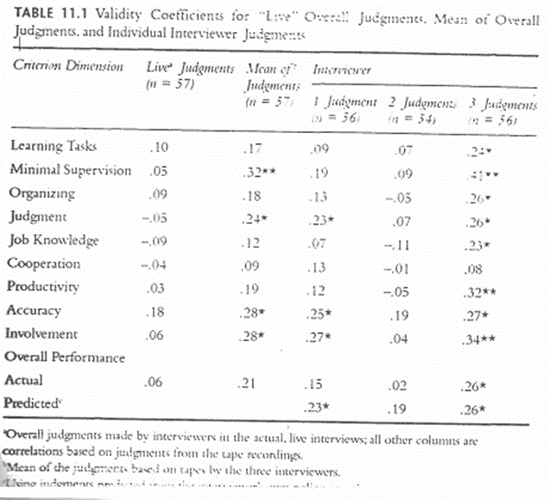
Dougherty et al. Table 11.1

Slide 18
INTERVIEWS
Interviewer Characteristics
Interviewer Experience and Habit
How important is experience?
Stereotypes, Prototypes, Biases
“similar to me” or “similar-ideal candidate”?
which is probably more valid?

Slide 19
INTERVIEWS Interviewer Characteristics
Biases
Possible demographics:
Sex, race, ethnicity, etc.
Evidence on “similar to me” ?
Gender?
Age?
Race and ethnic (Huffcut & Roth , 1998)
Judgment by representativeness
What is it? (Tversky & Kahneman, ‘82)

Slide 20
INTERVIEWS Interviewee Characteristics
Memory
Fallible it is!
Retrospective often does not represent the present perception
Impression Management
Would you expect that “Extraverted” or “Agreeable” applicants to be more ingratiating or self-promoting? (Kristof-Brown, et al. (2002)

Slide 21
Schmidt, Oh, Schaffer, wkg ppr

