Slide 1
Chapter 12 Assessing Via Ratings Rating Formats, Research on Rating, Errors & Rater Bias (2nd ed)
Focus is on
- Ratings as assessment methods,
- Criterion for evaluating validity of assessment
- not for performance appraisal
(as part of performance management)
Three things required:
1. source of information (observer, records)
2. organizing & remembering information (prep for rating)
3. evaluating what was remembered according to some rules
What’s a big difference in focus on types of ratings v. performance?

Slide 2
RATING METHODS
Some are “dependent” and others “independent of observational unit)
Graphic Rating Scales (don’t mix norm with domain referenced)
- note (d) in figure 12.1
What’s the best number of scaled values?
Should the scale have a midpoint or not?
Do there have to be specific scale values?
Employee Comparisons (often for merit with limited $$ Awards)
Method of Rank Order (allows for ties)
Method of Forced Distribution (with a large number to be rated)
What’s the difference between Rank Order and Forced Distribution?
What are the trade offs for using the forced distribution
Hint: the answer is not in the text but we have talked about it.
Method of Paired Comparisons

Slide 3
Rating Methods
Behavioral Descriptions
Behaviorally Anchored Rating Scales (BARS) (Smith & Kendall)
What is meant by “expectations” and “retranslation”?
Behavioral Observation Scales (BOS) (Latham & Wexley)
What are two advantages of BOS over BARS?
Behavior Summary Scales (BSS) (Borman, ‘86)
Developed for Navy recruiters
Specific behaviors from all sorts of sources!
Groups into 3s for four levels of effectiveness

Slide 4
Rating Methods, (Con’t)
Forced Choice Scales (Sisson, ’48)
Never liked by anyone! …but valid!
Four statements (two equally favorable and two unfavorable)
P+D+, P+D-, P-D+, P-D- (tetrads) (norm referenced)
(preference and discrimination index)
How does this one work?
Multisource ratings – 360s
Usually low correlations among rater types
Seeing different parts of the criterion space?

Slide 5
PSYCHOMETRIC RESEARCH ON RATINGS
Constructs Assessed
How could convergent validity be evidence of “converging bias”?
Agreement, Reliability, and Generalizability
What’s the difference between agreement and reliability? Hint: same rating v. order.
see Table 12.2 p 248
Which is better to have? (trick question)
Are the two raters in Table 12.3 in close enough agreement? Why?
See R&R table – hand out (re: Kraiger, 1990)
Improve reliability by averaging ratings from more sources
Validity Ratings as Predictors
But often the validity of the ratings is never assessed beyond rater agreement/reliability.

Slide 6
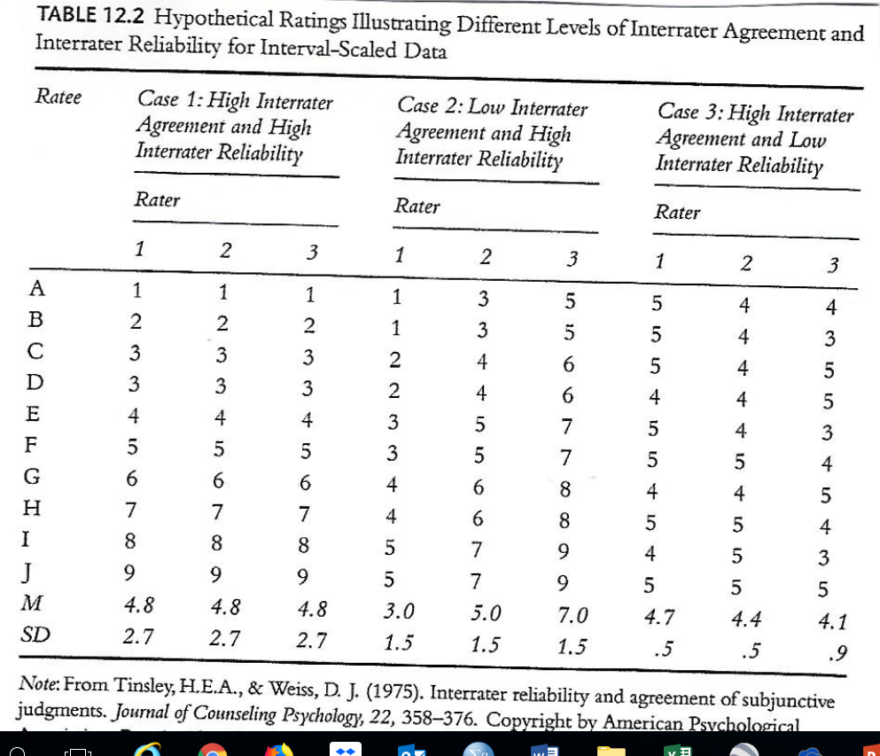

Slide 7
PSYCHOMETRIC RESEARCH ON RATINGS
Bias as Invalidity
Kraiger & Ford (1985)
Raters gave higher ratings to own race ratees
Sackett and DuBois (1991) (large USES data set)
Both Black and White raters-> higher ratings to Whites
On Army tech proficiency & personal discipline ratings
Both Black and White raters -> higher ratings to Blacks
On military bearing
Why did they differ?
Pre-post’70s? – a “social” zeitgeist?

Slide 8
THE RATER IN THE RATING PROCESS
The Classical Psychometric Errors
Central Tendency
Leniency or Severity
Halo ( E. Thornndike, (1920)
Could some variance in halo be real?
Could “implicit theory” of the rater be error or valid?
Other Psychometric Errors
Prior impression (knowledge of ratee’s prior performance)
Escalation bias (Knowledge of prior information on ratees)
What are some implications for the hiring process?

Slide 9
PSYCHOMETRIC RESEARCH ON RATINGS
Individual Differences in Ability to Rate
Rater Qualifications
relevant knowledge
demands on worker
Worker’s behavior
Knowledge comes from observation or experience
Who’s in the best position to judge? Self, 1st line super, 2nd level, peer?
See again, T 11.1 Overall judgments
Next slide

Slide 10
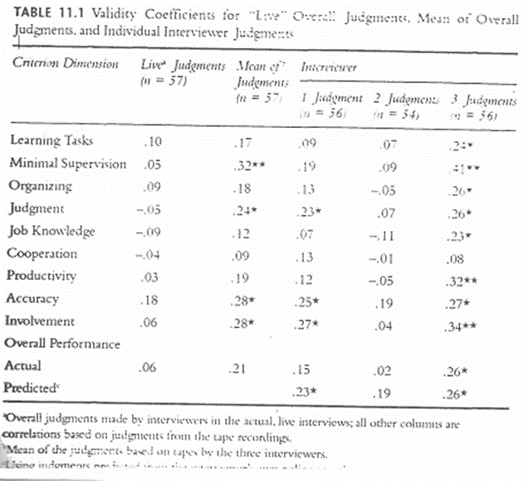

Slide 11
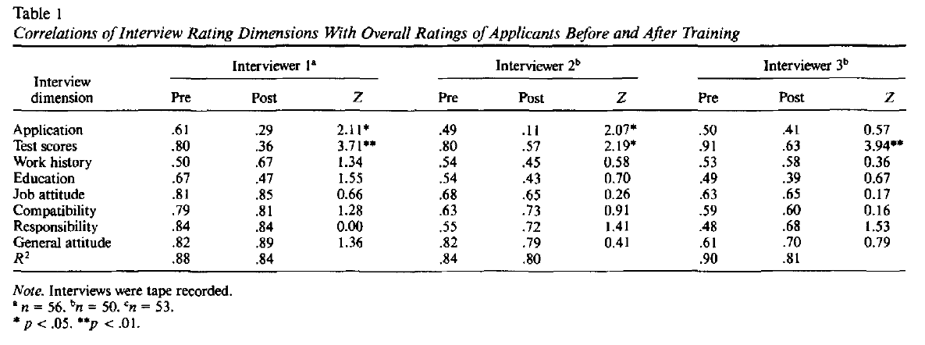
Dougherty et al (original article)

Slide 12
Individual Differences in Ability to Rate
Rater Qualifications
Experience, expertise
Training
Diary Keeping
Frame of Reference (FOR) Training
Training raters how to be critical
Is FOR training useful? (Day & Sulsky, ‘95)
Organizational Level
Different levels see different things
What are some advantages of self, peer, supervisor, customer ratings
Do they see different parts of the criterion space?
Give an example for your PAP job

Slide 13
Individual Differences in Ability to rate
Rater Motivation
Problems:
Lack of confidence
Distrust of researcher
Other things to do
Aids to Observation and Memory
Records
Incident Files or Diaries
A question of objective criteria
Can you find any for your PAP job?

Slide 14
Practical Considerations
To circumvent reduced range in ratings
Have supervisors rank order subordinates and then draw a line for where “acceptable” and “not performing well enough” is.
Ratings often do not match “objective data”
Which are more valid?
It depends
And you have to decide for yourself
What are some problems with turnover data?
Examples of invalid objective data?

