Slide 1
Chapter 13 Individual and Group Assessment
Complex Candidate Judgments
Individual Assessments
Assessment Centers

Slide 2
ISSUES IN COMBINING PREDICTORS
Decision Models
Additive
Well known and useful …and…
Compensatory
New concept: compensatory batteries
What is …”either or” or ….”if then?
What does the ADA have to do with it?
Judgmental (for individual assessments) v. Statistical
Cf judgmental vs. Statistical – which is better?

Slide 3
Issues in Combining Predictors
Tough Choices
Large applicant pools and top-down, no problem
What about small pools of candidates for one position?
What factors influence the decision?

Slide 4
INDIVIDUAL ASSESSMENT
Usually for executives or special positions
Performance is hard to define and few occupy the roles
Why do these assessment opportunities attract charlatans?
Holistic Approach (Henry Murray)
How good it this approach? (P. Meehl, ‘54)
Analytic Emphasis (history)
Approach:
Consultant visited clients to learn the job/org/context
Two psychologists interviewed and rated candidates w/o access to data on them
Projective tests were analyzed by clinician –blind to other information
Test battery developed to include
Two personality/ interest inventory/abilities tests
One psychologist –interviewer wrote the report
Two other programs:
EXXON and Sears – ’50s
Batteries included critical thinking / personality MRC .70 -.75!
Exec success = forcefulness, dominance, assertiveness, confidence
Although valid, legal concerns from ‘50s – ’60 damped down research

Slide 5
Improving Individual Assessment
Criticisms of Individual Assessment
Overconfidence in clinical judgments
True or false?
(Camerer & Johnson, ’91; Highouse, ‘02)
Psychometrics don’t apply to this type of assessment
Assessors wouldn’t be in business if they weren’t valid

Slide 6
Individual Assessments
Other criticisms:
Individual assessments is rarely subjected to validation
Conclusions are often unreliable (Ryan & Sackett, ‘89)
Summaries are often influenced by one or two parts which could be done alone
(they are judgments! And judgments often focus on negative & early cues!)
Great emphasis is usually placed on personality
When cognitive tests are usually more valid
Actual interpersonal interaction needs to be assessed
But need to be done with more than one person evaluating (assessment centers are useful)
May be ethically or legally questionable to seek information not explicitly relevant to the job
“Mr. Obama, can you tell us a little about your wife, Michelle?”

Slide 7
To Address these issues:
Use the appropriate designs -
Combine evidence of relevant traits with evidence from construct validities
Use well-developed predictive hypotheses to dictate and justify the assessment content
Use more work samples (or in-basket, SJT)
To assess interpersonal behavior
Personnel records / biodata / interview structure
Others?

Slide 8
Assessment Centers
Purposes
Often organizationally specific
To reflect specific values and practices
For managerial (Thornton & Byham, ‘82)
Early identification of potential
Promotion
Development
For personnel decisions – OAR (overall rating)

Slide 9
Assessment Centers (organization specific)
Purposes (calls for differences in assessment program design)
Promotion (Id potential managers) –succession planning
Management development
Assessment Center Components (need a JA)
Multiattribute and should be multimethod (more that one method for an attribute)
Tests and Inventories
Exercises (performance tests-work samples)
In-basket
Leaderless group discussions
do these have problems? Confounds?
Interviews
Should a stress interview be used? When? Give an example.
Assessors
Functions of Assessors (Zedeck, ‘86)
Observer and recorder
Role play
Predictor
Assessor Qualifications: (SMEs, HR, psychologists)
Number of Assessors: (2 candidates to 1 assessor)

Slide 10
Dimensions to be Assessed
See Table 13.2
Dimensions (usually not defined but should be)
Should be defined in behavioral terms (in a particular situation)
Ratings
Replication: Ratings on different predictors for the same dimension should generalize from one exercise to another
Would you predict that happens much?
Overall Assessment Ratings (OAR)
Should be a definable attribute
Or is it a composite of unrelated, but valid predictors?
Is consensus the way to go?
Can you think of an example?

Slide 11
ASSESSMENT CENTER PROBLEMS AND ISSUES
Construct Validities of Dimension Assessments
Dimensional Consistency (across exercises):
rs should not be high but substantial. Why?
Results of factor analyses
Are the factors (in Table 13.3, defined by the exercise or dimensions?
Is this consistent with Sackett & Drehers, ‘82 findings?
Reasons for inconsistency in dimension ratings
Two viewpoints:
Are the dimensions relative enduring or situational specific? Or contingent?
Solutions? the OAR Maybe the dimensions are just a small number of cognitive and personality factors
A behavioral checklist perhaps?
Criterion-Related Validities (review of meta-analytic studies)
Predictive validity higher with multiple measures
Validities higher when peer evals included
Background and training moderates validity
4 dimensions account for most of the variance
Validities higher for managerial progress v. future performance

Slide 12
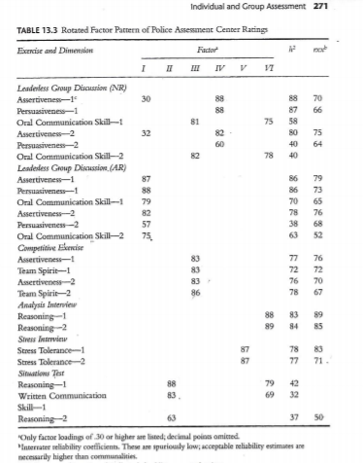

Slide 13
Point of View
What is the authors’ on Assessment Center validity?
What do they recommend?
--behaviorally based ratings
-using checklists

