Slide 1
Part II Knowing How to Assess Chapter 5 Minimizing Error
Review of Appl 644 Personnel Psychology
Measurement Theory
Reliability
Validity
Assessment is broader term than Measurement
What does this mean?
Notes:
Measurement = precision, a defined scale
Assessment = other assessment is often ad hoc, for specific purposes

Slide 2
Background
Queletet (1835)
Established the normal distribution
Used by:
Galton (measurement of genius)
Binet et al. (cognitive ability, i.e.”IQ”)
Munsterberg (employment testing)
J. M. Cattell (perceptual and sensory tests)
Over time measurement
Focus changed from reliability to validity

Slide 3
Background in Measurement
Adolphe Quetelet – (1835)
conception of the homme moyen (“average man”) as the central value about which measurements of a human trait are grouped according to the normal distribution.
Physical and mental attributes are normally distributed
Errors of measurement are normally distributed
Foundation for psychological measurement

Slide 4
RELIABILITY CONCEPTS OF MEASUREMENT ERROR
Measurement Error and Error variance
(error happens!)
Table 5.1 Reasons for differences in performance
I Person characteristics –long term, permanent
Influence scores on all tests, e.g. language, skills
II Person characteristics specific to test permanent
E.g type of words on test more/less recognizable to some
III temporary characteristics that
Influence scores on any test (e.g. evaluation apprehension)
IV Temporary and specific to the test
E.g. stumped by a word, e.g.
V Administration effects
E.g. interaction administrator and examinee
VI pure chance
Which is the one of primary interest (non-error variance)?

Slide 5
Measure Error and Error Variance (con’t)
Category II A – of most interest
Others reflect unwanted sources of variance
Classical theory:
X = t + e
Assumptions: (errors are truly random)
Obtained score = algebraic sum of t + e
Not correlated:
t scores and e scores (in one test not correlated)
errors in different measures (not correlated)
errors in one measure with true scores in another (not correlated)

Slide 6
Measurement Error
X_{ob} = s + e (one individual’s score)
Why was t replaced with s?
total variance (all of an individual’s scores)
σ_{x}² = σ_{s}² + σ_{e}² (all people’s scores – population)
systematic causes + random error
systematic =
wanted systematic var (true ability) +
unwanted systematic (error) (test-wise)
e.g., prefer type of format (systematic error)
e.g. sleepy every time he takes the test

Slide 7
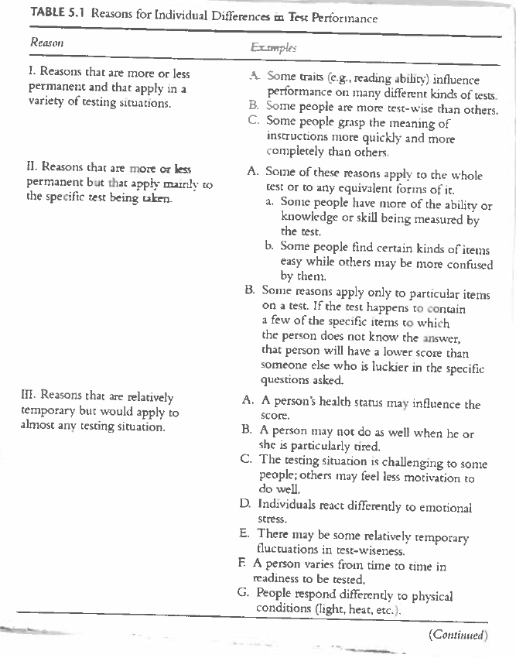

Slide 8
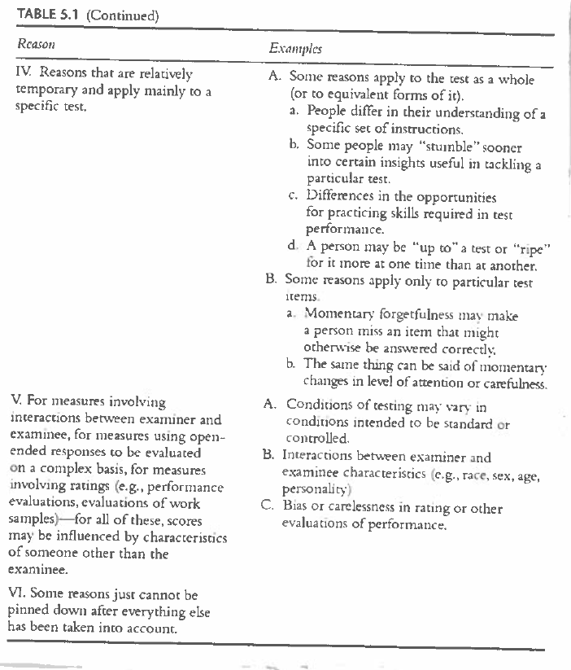

Slide 9
Reliability
Is…Consistency – in sets of measures
Free from random error variance
Measurement error = random sources of var
(not unwanted systematic error)
Reliability = 1 – (random sources of var/total variance )
r_{xx} = 1 – ($σ_{}^{2}e$ /$σ_{}^{2}$_{x} )
Reliability also defined also as:
“proportion of total var attributable to systematic sources (wanted and unwanted)

Slide 10
Reliability (con’t)
A necessary (but not sufficient) condition for validity
(reliability places a ceiling on validity)
Theoretical relationship between reliability and validity:
r_{xoo} (test) r_{yoo} (crit)= r_{xy} /$√$(r_{xx} * r_{yy)}
Why would you want to know what the validity coefficient would be if it were corrected for attenuation in both the test and criterion?

Slide 11
Reliability and Validity
Correction for unreliability (attenuation) in the criterion (why not for the test as well?)
Obtained validity coefficient r_{xyoo =} r_{xy} / $√$ r_{yy}
_{(for the criterion only)}
Assume:
Obtained validity coefficient = .40
Reliability of criterion is .25
What is the estimated validity coefficient corrected for attenuation in the criterion?
What is the coefficient of determination?

Slide 12
Accuracy / Reliability/ Validity
Accuracy is ≠ reliability
An inaccurate thermometer may be consistent (reliable)
Accuracy is ≠ validity
An inaccurate thermometer may show validity (high correlations with Bureau of standards instrument
But is inaccurate (consistently lower for each paired observation), i.e. not accurate (Figures 5.1; 5.2)
Why is the concept of “accuracy” meaningless for psychological constructs?

Slide 13
RELIABILITY ESTIMATION
Coefficients of Stability
Over time (test-retest)
Coefficients of Equivalence
Equivalent forms (e.g. A and B)
(errors in sampling test content domain)
Coefficients of Internal Consistency
Kuder-Richardson Estimates
(assumes homogeneity)
K-R 20 (preferred)
Cronbach’s alpha α (general version of K-R 20)
Where is this in SPSS?

Slide 14
Reliability Estimation (con’t)
Inter-rater Agreement v. reliability
ICC
Rwg
% agreement (Kappa)
See Rosenthal & Rosnow table (hand out)
Comparisons Among Reliability Estimates
Systematic variance must be stable characteristics of
examinee
what is measured
Use estimates that make sense for the purpose,
For re-testing an applicant due to admin mistake what’s most appropriate?
For production over a long period?
An e.g. of a job requiring stability of an attribute?

Slide 15
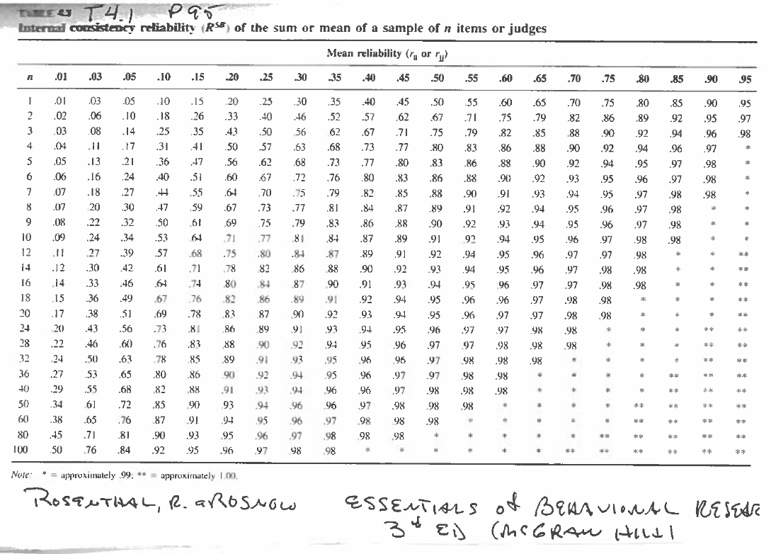

Slide 16
RELIABILITY ESTIMATION
Standard Error of Measurement:
s_{e} = s_{x} $\sqrt{\text{1−}\text{r}\text{xx}}$
Where (in test score units)
s_{e} = SEM; s_{x} = SD of test; r_{xx} = reliability of test
SEM decreases as reliability increases
Three purposes: to determine if
Two individuals’ scores really differ
Individual’s obtained score differs from true score
Scores discriminate differently in different groups
Do group scores from different geographical areas matter?
Why? Give an example

Slide 17
INTERPRETATIONS OF RELAIBILITY COEFFICIENTS
Important to remember:
Size of coefficient needed depends upon:
The purpose for which it is used
The history of the type of measure
what would be acceptable for a GMA test?
for a panel interview?
Length of test (how many items are needed?)

Slide 18
VALIDITY: AN EVOLVING CONCEPT
Why is it important for I/O to distinguish between
A Test “… purports to measure something”
validity: “the degree to which it predicts something else” (i.e. criterion)
(making inferences)
Three Troublesome Adjectives
Content, criterion related, construct
(“kinds v. “aspects”)
Meaning (interpretation) v. inferences about a person
“Unitarian” view that they are all aspects of Construct validity
Descriptive and Relational Inferences
Descriptive inferences (about the score itself)
High IQ means the person is smart (trait)
Relational inferences (about what can be predicted)
High scorer will perform on the job (sign)

Slide 19
Psychometric Validity v. Job Relatedness
Psychometric Validity
Confirm the meaning of the test intended by the test developer
Job-relatedness (validity) – in Personnel assessment
Examples?
How does psychometric validity differ from Job-relatedness ?

Slide 20
VARIETIES OF PSYCHOMETRIC VALIDITY EVIDENCE
Evidence Based on Test Development
Provide evidence for a test you plan to use
questions to guide evaluation: answer them for your job
Did the developer have a clear idea of the attribute?
Are the mechanics of the measurement consistent with the concepts?
Is the stimulus content appropriate?
What the test carefully and skillfully developed?
Evidence Based on Reliability
- questions to guide evaluation: answer them for your job
Is the internal statistical evidence satisfactory?
Are scores stable over time and consistent with alternative measures?
Notes:
Example: small scaled model of a steam engine (for apprentice to become journeyman)

Slide 21
Evidence from Patterns of Correlates
Confirmatory and dis-confirmatory
Questions for evaluation:
Answer them for a test you will use
Does empirical evidence confirm logically expected relations with other variables?
Does empirical evidence disconfirm alternative meanings of test scores?
Are the consequences of the test consistent with the meaning of the construct being measured?
Notes:
Compare FFM to EQ

Slide 22
Beyond Classical Test Theory
Factor Analysis (identify latent variables in a set of scores)
EFA (Exploratory)
CFA (Confirmatory)
Which would be most likely to be used to develop a test?

Slide 23
GENERALIZABILITY THEORY
Can the validity of the test be generalized to:
other times?
Other circumstances?
Other behavior samples?
Other test forms?
Other raters/ interviewers?
Other geographical populations?
Give an example of where a test will not perform the same for applicants in different geographical locations

Slide 24
ITEM RESPONSE THEORY
Classical test:
A person’s score on a test relates to others
IRT
A person’s score on a test reflects standing on the latent variable
(i.e. “sample free”)
Computerized adaptive testing with IRT
Analysis of Bias with Adverse Impact
Differential item functioning
to assess adverse impact

Slide 25
Formulas for midterm:
r = ∑z_{x}z_{y} / N
r_{xx} = 1 – ($σ_{}^{2}e$ /$σ_{}^{2}$_{x} )
r_{xyoo =} r_{xy} / $√$ r_{yy}
r_{xooyoo} = r_{xy} / $√$(r_{xx} r_{yy})
s_{e} = s_{x} √ 1 - r_{xx}

