Slide 1
The Uniform Guidelines are a Detriment to the Field of Personnel Selection Michael A. McDaniel Sven Kepes George Banks Virginia Commonwealth University Paper prepared as a focal article in Industrial and Organizational Psychology: Perspectives on Science and Practice

Slide 2
The Unfulfilled Promises of the Uniform Guidelines
The Uniform Guidelines was jointly issued in 1978 by the four agencies.
Employment Opportunity Commission
he U.S. Civil Service Commission,
The Department of Labor
Department of Justice
Uniform Guidelines were intended to be consistent with professional practice and scientific findings.
Uniform Guidelines assert that new scientific findings would be evaluated. “new strategies for showing the validity of selection procedures will be evaluated as they become accepted by the psychological profession.”
The authors of the Uniform Guidelines indicated that the guidelines and their interpretation should recognize advances in scientific knowledge and professional practice.
The Uniform Guidelines have failed to keep their promises to maintain and update the Uniform Guidelines.

Slide 3
The Uniform Guidelines embrace the situational specificity hypothesis
From the 1920’s to the 1970’s, it was observed that the same employment test yielded different validity results across settings (Schmidt & Hunter, 1998).
It was believed that there were as yet undiscovered characteristics of employment situations that caused a test to be valid for one location, but not for another. (The situational specificity hypothesis)
Therefore, the Uniform Guidelines emphasized the practices of detailed job analyses and local validation studies.
Beginning in 1977, Schmidt and Hunter began publishing empirical evidence discrediting the situational specificity hypothesis.
Demonstrated that much of the variability in validity coefficients across studies was due to random sampling error.
For instance, a test with a population validity of .20 could easily yield sample validities ranging from -.04 to .421 based on sample sizes of 68.
Thus, small sample studies make validity coefficients appear unstable even when they are constant in the population.

Slide 4
The emphasis of the Uniform Guidelines on local validation studies
The Uniform Guidelines require validity evidence when a test demonstrates adverse impact (i.e., differential hiring rates by race, sex, etc.).
Yet, for most employers, local empirical validity studies are professionally ill-advised due to sample-size limitations.
In contrast, the Uniform Guidelines are largely oblivious to sample size issues in test validation.
The Principles acknowledge that “validation planning must consider the feasibility of the design requirements necessary to support an inference of validity. Validation efforts may be limited by time, resource availability, sample size, or other organization constraints including cost” (p. 10).
The employees of small- to medium-sized businesses would likely be found in multiple occupations, further reducing the sample size available for a concurrent validation study of a single occupation.
Likewise, such small employers are likely to hire relatively few employees in a given time period, making predictive validity studies unfeasible as well.

Slide 5
The Uniform Guidelines and evidence for validity based on content similarity
Uniform Guidelines advise as to what job-related personal characteristics can and cannot be defended based on content evidence.
Without any stated science-based justification, the Uniform Guidelines declare:
A selection procedure based upon inferences about mental processes cannot be supported solely or primarily on the basis of content validity. Thus, a content strategy is not appropriate for demonstrating the validity of selection procedures which purport to measure traits or constructs, such as intelligence, aptitude, personality, commonsense, judgment, leadership, and spatial ability. (Section C1)
Uniform Guidelines appears to rule out a content validity defense for some very common selection constructs including general and specific tests of cognitive ability and the Big 5 personality traits.
This would exclude content validity as a defense for most interviews, assessment centers, and situational judgment tests to the extent that the measures seek to assess constructs associated with cognitive ability, personality, and leadership.

Slide 6
Few employers have sufficient employees or applicants to conduct a criterion-related validity study, and they are further precluded from using a content validity strategy to defend reasonable tests of cognitive ability or personality.
The Principles note the value of a less detailed approach to job analysis than is found in the Uniform Guidelines:
A less detailed analysis may be appropriate when prior research about the job requirements allows the generation of sound hypotheses concerning the predictors or criteria across job families or organizations.
When a detailed analysis of work is not required, the researcher should compile reasonable evidence establishing that the job(s) in question are similar in terms of work behavior and/or required knowledge, skills, abilities, and/or other characteristics, or falls into a group of jobs for which validity can be generalized. (p. 11)
The cost and time constraints make the Uniform Guidelines content validity requirements burdensome for many U.S. employers.
Criterion-related validity study is likely to be infeasible for the majority of U.S. firms. Most will lack the financial and technical resources to fully comply with the requirements.

Slide 7
The Uniform Guidelines and evidence for validity based on construct validity
Uniform Guidelines state that..
Construct validity is a more complex strategy than either criterion-related or content validity.
Construct validation is a relatively new and developing procedure in the employment field, and there is at present a lack of substantial literature extending the concept to employment practices.
The user should be aware that the effort to obtain sufficient empirical support for construct validity is both an extensive and arduous effort involving a series of research studies, which include criterion related validity studies and which may include content validity studies.
Users choosing to justify use of a selection procedure by this strategy should therefore take particular care to assure that the validity study meets the standards set forth below. (Section D1)
This wording made it largely impossible to use construct evidence as a validity defense under the Uniform Guidelines.

Slide 8
The Uniform Guidelines have never been revised with respect to construct validity.
In contrast, the Principles and Standards recognize the importance of varied approaches to construct evidence in support of validity. For example, the Principles state that
“evidence that two measures are highly related and consistent with the underlying construct can provide convergent evidence in support of the proposed interpretation of test scores as representing a candidate’s standing on the construct of interest” (p. 5).
The Principles also discuss the usefulness of discriminant validity and the value of evidence relating to the internal structure of the test.
For example, a high degree of item internal consistency would be supportive of a test argued to represent a single construct.

Slide 9
The Uniform Guidelines and its 1950’s perspective on separate “types” of validity
The Principles note that in the early 1950s, three different types of test validity were considered.
1. Content
2. Criterion-related
3. Construct.
The measurement literature has since adopted the perspective that validity is a unitary concept in which different sources of information can inform inferences about test scores.
The Principles emphasize that …
“nearly all information about a selection procedure, and inferences about the resulting scores, contributes to an understanding of its validity.”

Slide 10
The Uniform Guidelines and meta-analysis as a source of validity documentation
The early work of Schmidt and Hunter and colleagues concerning situational specificity evolved into psychometric meta-analysis procedures (Hunter & Schmidt, 2004).
The application of meta-analysis to validity data became known as validity generalization.
A test was argued to show validity generalization when a large majority (typically 90%) of population validities were above zero.
The Standards and the Principles endorse validity generalization as evidence of the validity of employment tests.
Research has shown much of the variation in observed differences in obtained validity coefficients in different situations can be attributed to sampling error
From the perspective of scientific knowledge, meta-analytic evidence largely eliminates the need for local validity studies.
In addition to the acceptance of validity generalization in professional standards, courts have found in favor of generalizing validity evidence (see Sharf,2006).
The Uniform Guidelines have never been revised to acknowledge the role of meta-analysis in demonstrating the validity of employment tests.

Slide 11
The Uniform Guidelines and restrictions on transportability of evidence
Transportability refers to using information from a primary validity study to generalize validity to the use of the test in a new situation.
The Principles address the value of transportability evidence in the documentation of the validity of employment tests. When proposing to “transport” use of a procedure several things must be done.
a careful review of the original validation study to ensure acceptability of the technical soundness of that study and to determine its relevance to the new situation.
job comparability analysis to determine comparability of content or requirements
Determination of similarity of job context and candidate group
The Uniform Guidelines only mentioned transportability with respect to criterion-related validity and regard transportability of validity evidence based on content or construct relevance difficult – inconsistent with scientific knowledge and professional guidelines.

Slide 12
The Uniform Guidelines position with respect to differential validity and differential prediction
Differential Prediction and Differential validity research resulted from
Belief in the situational specificity hypothesis
Common observation of mean racial differences in test scores
It was argued that the validity (i.e., differential validity) or the prediction accuracy (i.e., differential prediction) may vary by ethnic and racial group.
However, during the late 1970’s and early 1980’s, it became evident that differential validity was rare (Schmidt, 1988; Schmidt & Hunter, 1981; Wigdor & Garner, 1982).
When it does occur it results from either differing slopes or differing intercepts.

Slide 13
What do test differences indicate?
Differential validity?
Do tests like SAT, GRE have same validity when applied to different groups?
If test is valid for majority group, and invalid for minority group, this presents a problem in using the test as a criterion for selection

Slide 14
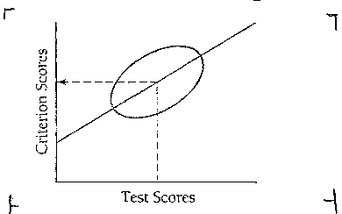
Standard Regression Plot

Slide 15
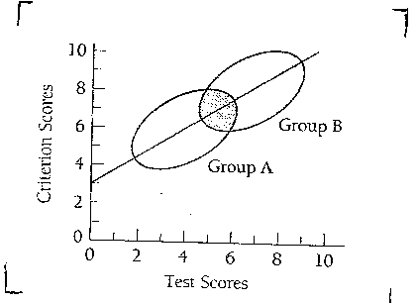
Single Regression Slope for Two Groups

Slide 16
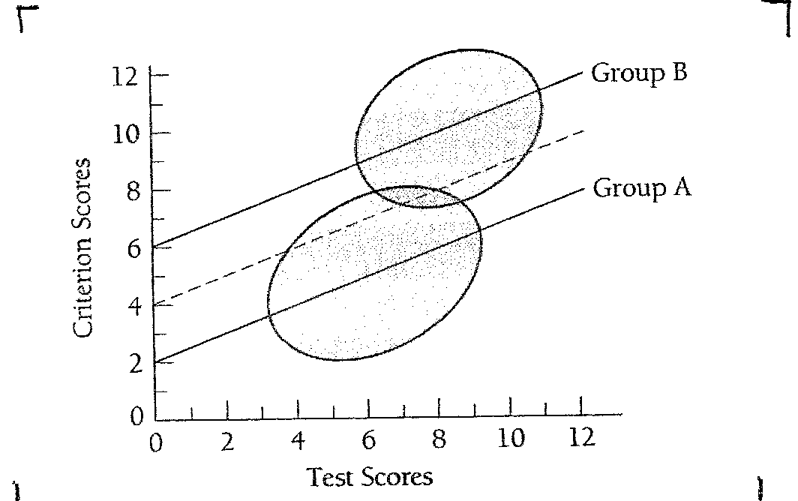
Regression – Two Groups with Equal Slopes but Different Intercepts
Notes:
This seems to represent the SAT
In this situation, regression using average line overpredicts scores of minority students, and underpredicts scores of majority students
E.g., what would the prediction be for a student with a test score of 8?

Slide 17
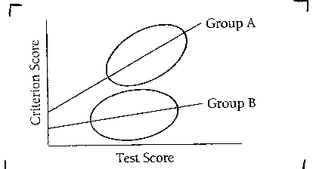
Regression Lines with Different Slopes

Slide 18
Regression Lines with Different Slopes

Slide 19
Regression Lines with Different Slopes

Slide 20
By the late 1970’s, it was demonstrated that differential prediction by slope does not occur at higher levels than expected by chance (Bartlett, Bobko, Mosier, & Hannan, 1978).
Differential prediction by intercept is less rare, but the error in prediction tends to favor minority groups (Hartigan & Wigdor, 1989; Schmidt, Pearlman, & Hunter, 1980b).
Thus, accumulated scientific knowledge indicates that…
“Differential validity does not exist” (Gatewood, Feild, & Barrick, 2008, p. 547)
Differential prediction typically does not occur, and when it does, it tends to favor minority groups (Hartigan & Wigdor, 1989; Schmidt et al., 1980b),
The Uniform Guidelines have not been revised to be consistent with current scientific knowledge.

Slide 21
The Uniform Guidelines and false assumptions concerning adverse impact
The Uniform Guidelines incorporate the 4/5ths rule to determine if adverse impact is present. If the ratio of the minority hiring rate is less than 80% of the majority hiring rate, adverse impact is generally considered present.
The 4/5ths rule has no scientific basis and there are debates concerning its value (Cohen, Aamodt, & Dunleavy, 2010; Roth, Bobko, & Switzer, 2006; Shoben, 1978).
Uniform Guidelines: Showing adverse impact necessitates a test validation defense.
But can prove to be very expensive, particularly for small and medium size employers that comprise the large majority of U.S. employers.
An implicit assumption of the Uniform Guidelines is that adverse impact is an indication of a flawed test.
Given the prevalence of mean racial differences, employers are typically in need of a validation defense consistent with Federal regulations.
Thus, it is imperative that Federal regulations permit all scientifically-based approaches to validity evidence. Currently, they do not.

Slide 22
When faced with the adverse impact of an employment test, the Uniform Guidelines encourage employers to search for alternative tests with the same or higher validity, but less adverse impact. Such searches are almost always futile.
Organizations can use two strategies to deal with this diversity-validity dilemma (Pyburn et al., 2008).
First, they can sacrifice validity and use less valid selection tests that do not result in adverse impact to achieve social, ethical, or business aims
Second, organizations can sacrifice diversity by ignoring the potential adverse impact of valid selection procedures to achieve different social, ethical, or business aims.
Thus, both strategies ultimately impinge on important social, ethical, and economic objectives (Pyburn et al., 2008).
Unfortunately, the Uniform Guidelines do not address this vital issue

