Slide 1
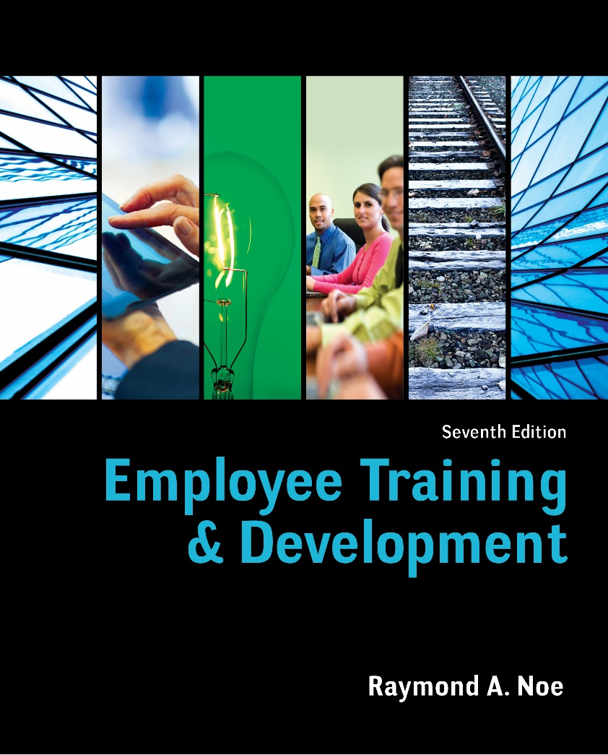
Chapter Nine
Employee Development & Career Management

Slide 2
Objectives
Discuss the steps in the development planning process
Explain the employees’ and company’s responsibilities in planning development
Discuss current trends in using formal education for development
Relate how assessment of personality type, work behavior, and job performance can be used for employee development

Slide 3
Objectives
Explain how job experiences can be used for development and suggest a job experience to match an employee’s development goal or need
Identify the characteristics of an effective mentoring program
Describe the succession planning process and how the nine-box grid is used
Design an effective on-boarding process

Slide 4
Development is Key
Helps managers understand their strengths, weaknesses, and interests
Helps managers expand responsibilities to meet their growth needs
Increases retention of valuable managers
Ensures employees have needed competencies
Helps increase employee engagement

Slide 5
Development & Training
Development refers to learning experiences that help employees grow and prepare for the future
Development often involves voluntary learning not tied directly to the current job
Training is related to the current job and typically required

Slide 6
Careers
Traditionally, careers have been described in a variety of ways:
as a sequence of positions held within an occupation
in the context of mobility within an organization
as a characteristic of the employee—one’s career

Slide 7
The Protean Career
A protean career is based on self-direction, whereby one’s career is driven by the person vs. the organization
A key goal in protean careers is to achieve psychological success
Employees need to develop new skills rather than rely on static knowledge

Slide 8
Boundaryless Careers
Today’s careers are “boundaryless”
Boundaryless means that individuals identify more with a job and profession than an employer
Most employees are unlikely to stay at one company for their entire career or even for a significant portion

Slide 9
Development Planning
Self-assessment—identifying opportunities and areas for improvement
Reality check—identifying what needs are most realistic to develop
Goal setting—establishing goals to focus development efforts
Action planning—creating a plan to determine how goals will be achieved

Slide 10
Approaches to Development
Formal Education
Executive Education
Personality Tests
Assessment Center
Performance Appraisal
360-Degree Feedback
Enlarging the Current Job
Job Rotation
Lateral Moves
Transfers
Promotions
Downward Moves
Temporary Assignments
Volunteer Work
Sabbaticals
Mentoring
Coaching
Succession Planning

Slide 11
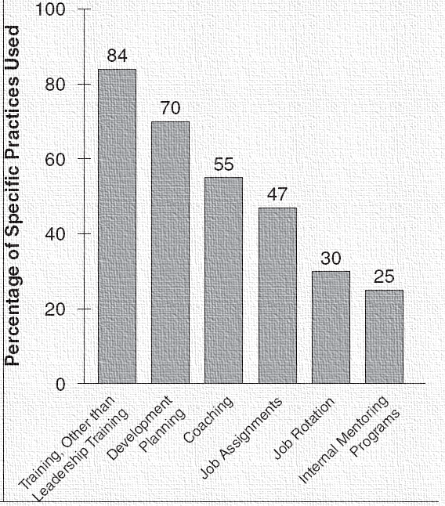
Frequency of Practices

Slide 12
Formal Education
Formal education may take many forms
on-site or off-site programs tailored specifically for a company’s employees
short courses offered by consultants or academic institutions
on-campus university programs
Many companies provide tuition reimbursement

Slide 13
Executive Education
Includes executive MBA programs and specialized curricula on topics such as leadership, entrepreneurship, and global business
Blended learning is common
Educational institutions have begun offering in-house, customized programs

Slide 14
Assessment
Involves collecting information and providing feedback about behavior, communication style, and skills
Assessment may help:
identify managerial potential
identify strengths and weaknesses of members in teams
self-awareness

Slide 15
NEO Personality Inventory
The Big Five personality dimensions:
emotional stability (relaxed, non-worrier)
extraversion (sociable, outgoing)
openness (willing to try new things)
agreeableness (friendly, polite)
conscientiousness (hardworking, detail oriented)

Slide 16
The DISC
Measures personality and behavioral style:
dominance (directness, forcefulness)
influence (sociability, persuasiveness)
steadiness (cooperativeness, dependability)
conscientiousness (accuracy, competency)

Slide 17
Myers-Briggs Type Indicator
Identifies 16 personality types based on preferences for:
introversion (I) or extraversion (E)
sensing (S) or intuition (N)
thinking (T) or feeling (F)
judging (J) or perceiving (P)
Each personality type has implications for work habits and interpersonal relationships

Slide 18
Assessment Centers
Multiple raters assess employees in a number of exercises
Typically used to identify personality characteristics, administrative skills, and interpersonal skills for managerial jobs
Increasingly used to determine if employees have the skills to work in teams

Slide 19
Assessment Center Exercises
Leaderless Group Discussion
In-Basket Exercise
Interview
Role-Play

Slide 20
360-Degree Feedback
Feedback is obtained from subordinates, peers, customers, managers, and employees themselves
Individuals complete questionnaires rating the employee on a number of different dimensions

Slide 21
Benefits of 360
There are many benefits of 360:
Feedback is obtained from multiple perspectives
Employees gain a better perspective of their strengths and areas for improvement
These systems help to formalize the feedback process

Slide 22
Challenges with 360
Potential limitations include:
Time demands placed on raters
Employees may retaliate against raters
Facilitators may be required to interpret results
Companies may fail to provide opportunities to act on feedback

Slide 23
Job Experiences
Most development occurs through job experiences
Development most likely occurs when employees are given “stretch” assignments
Job experiences perceived as positive stressors challenge employees and stimulate learning

Slide 24
Enlarging the Current Job
Job enlargement involves adding challenges and new responsibilities to the current job
“Two-in-a-box”
Enlarging jobs by giving two managers the same title and responsibilities and allowing them to divide work as they see fit

Slide 25
Job Rotation & Lateral Moves
A series of assignments in different functional areas of the company or within a single functional area
Job rotation helps employees gain an overall appreciation of the company and develop a network
Lateral moves help retain employees who want new experiences

Slide 26
Effective Job Rotation
Linked to specific developmental needs
Provides experiences needed for managerial positions
Employees understand the skills to be developed
Timed to minimize workload costs
All employees are given equal opportunity

Slide 27
Temporary Assignments, Volunteering & Sabbaticals
Temporary assignments involve exchanging employees so companies can better understand each other
Community volunteer assignments may provide opportunities to learn new skills
A sabbatical involves a leave of absence to renew or develop skills

Slide 28
Transfers, Promotions & Downward Moves
A transfer involves reassigning an employee to a different area of the company
A promotion involves advancement to a position of greater responsibility and authority
A downward move involves a position with less responsibility

Slide 29
Buy-In for Relocation
Provide information about content, challenges, and benefits
Send the employee to preview the new location
Educate how the new job will affect income, taxes, and expenses
Assist with selling and securing housing
Assign a host to help with adjustment
Provide an orientation program

Slide 30
Mentoring
Involves an experienced, senior employee helping to develop a less experienced one
Helps socialize new employees, develop managers, and provide opportunities without regard to race and gender
Most relationships develop informally, but some companies have formal programs

Slide 31
Protégé Benefits
Benefits for protégés include:
career support
psychosocial support
skill development
higher rates of promotion
higher salaries
greater organizational influence

Slide 32
Mentors Benefit Too
Benefits for mentors include:
developing interpersonal skills
increased self-esteem
increased sense of worth to the company
access to new knowledge in their field

Slide 33
Formal Mentoring Programs
Carefully select mentors
Make participation voluntary
Ensure the process does not hinder informal relationships
Match based on how the mentor’s skills can meet a protégé’s needs
Clarify roles and expectations
Specify a minimum amount of contact time
Encourage continued relationships

Slide 34
Coaching
A peer or manager who works with an employee to develop skills, motivate, and provide feedback
A coach can play three roles:
developing high potential managers
helping employees learn for themselves
providing valuable resources

Slide 35
Resistance to Coaching
Managers may be reluctant to discuss performance problems
Managers may be better able to identify performance issues than solve them
Managers may believe employees perceive coaching as criticism
Managers may not have time to coach

Slide 36
Succession Planning
Identifying, developing, and tracking employees who are capable of moving into different positions
Key benefits
prepares future leaders and builds “bench strength”
minimizes disruptions when key employees leave
helps plan development experiences
attracts and retains employees

Slide 37
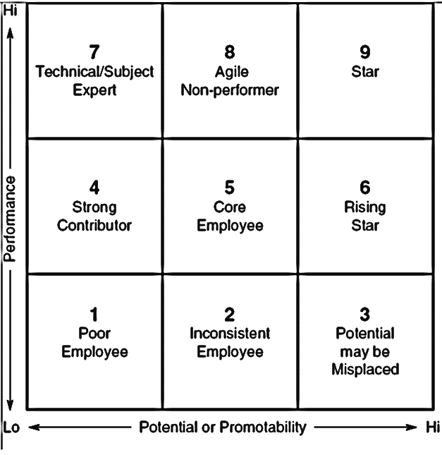
Nine Box Grid

Slide 38
Should results be public?
Advantages
employees may stay because they understand promotion prospects
employees who are not interested may communicate their intentions
Disadvantages
employees not targeted may become discouraged and/or leave

Slide 39
Dysfunctional Behaviors
Development may help alleviate dysfunctional behaviors
“Toxic” behaviors include insensitivity, aggression, arrogance, and poor conflict-management skills
A combination of assessment, training, and counseling could be used

Slide 40
Onboarding
Compliance—legal and policy-related rules and regulations
Clarification—job and performance expectations
Culture—company history, traditions, values, and norms
Connection—developing formal and informal relationships

Slide 41
Effective Onboarding
Focus on technical and social aspects of work and organizational culture
There is active involvement and employees are encouraged to ask questions
This is interaction between new hires and seasoned employees
Managers are involved
There is follow up at different points during the first year

